Slide 1


Challenges to the AGN Unified Model
Stefano Bianchi
18th Serbian Astronomical – Belgrade – October 17th 2017

Slide 2
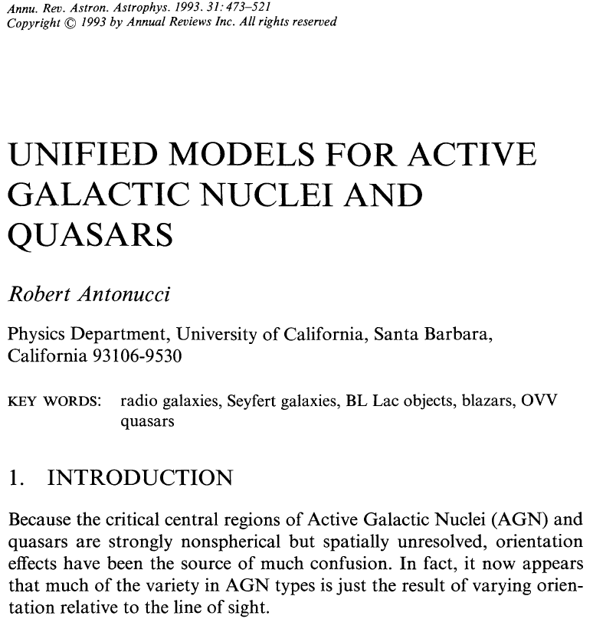
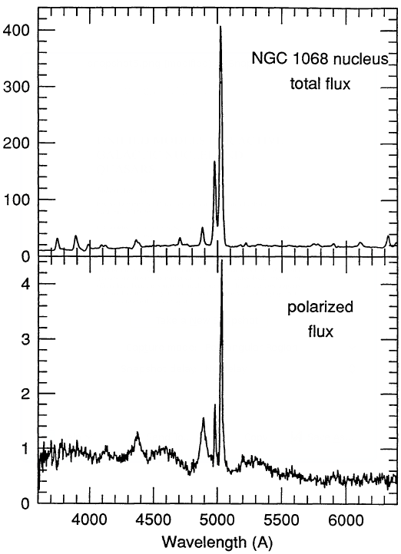
Antonucci (1984) found a perpendicular alignment of optical polarization relative to the radio axis in a sample of radio galaxies, as due to scattering of photons originally emitted in the ‘vertical’ direction
Broad optical lines in the polarized spectrum of the archetypal Seyfert 2, NGC 1068, led Antonucci (1993) to postulate the equivalence between Type 1 and Type 2 AGN, any observational difference due to obscuration along the line-of-sight to the source
Notes:
2

Slide 3
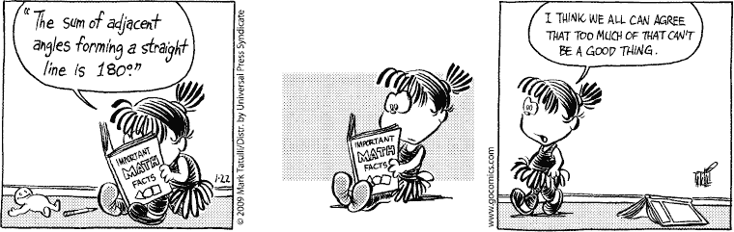
The Geometry of Absorption

Slide 4





















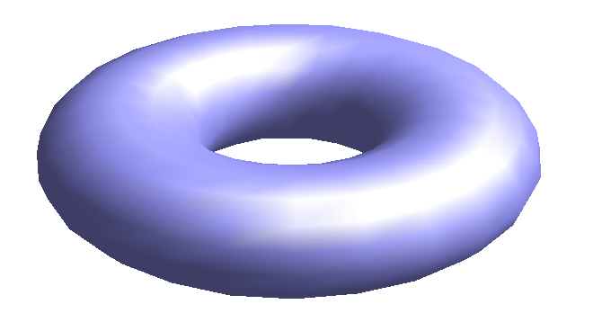










The absorber: The Unification Model view
NLR
The absorber must break the symmetry of the polarization angles
A “torus” is the most natural configuration
BLR
BLR
Torus
The size of the torus was postulated to be on the parsec scale
Large enough to obscure the BLR
Small enough not to obscure the NLR
(Krolik & Begelman, 1986, 1988)

Slide 5
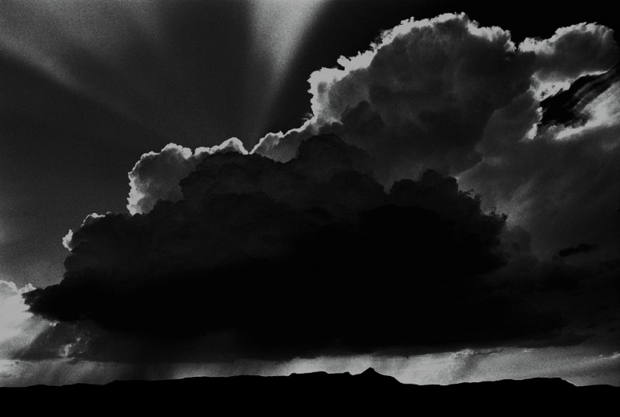
From Galactic to Sub-Pc Scale: Absorption at Different Scales
A nonspherically symmetric absorber is still the likely origin of the Type 1/Type 2 dichotomy, but several new observations and models suggest that multiple absorbers are present, on quite different physical scales
Sublimation Radius
pc-scale Torus
Host Galaxy

Slide 6
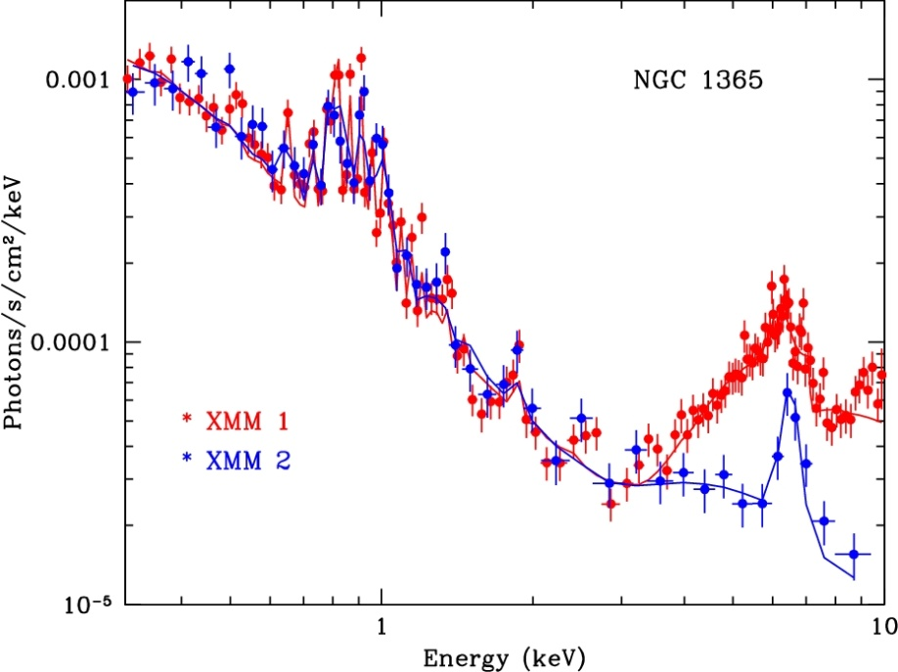
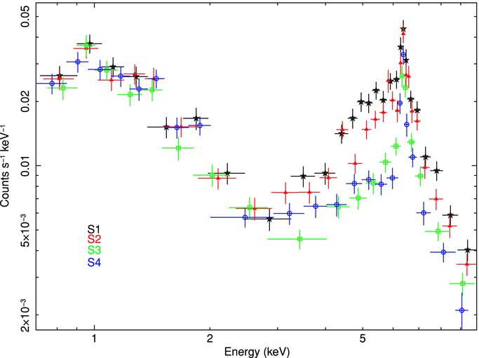
Absorption within the Sublimation Radius
X-ray absorption variability is common in AGN:
the circumnuclear X-ray absorber (or, at least, one component of it) must be clumpy and located at subparsec distance
Risaliti+ 2007
N_{H} variations on scales from months to hours are found in a growing number of sources: NGC 1365 (Risaliti et al. 2005, 2007, 2009), NGC 4388 (Elvis et al. 2004), NGC 4151 (Puccetti et al. 2007), NGC 7582 (Bianchi et al. 2009), Mrk 766 (Risaliti et al. 2011)
NGC 7582
ΔN_{H}~10²³ cm⁻²
ΔΤ∼20 hours
Bianchi+ 2009

Slide 7
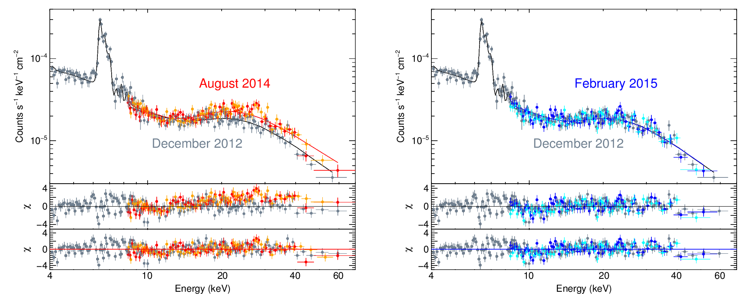
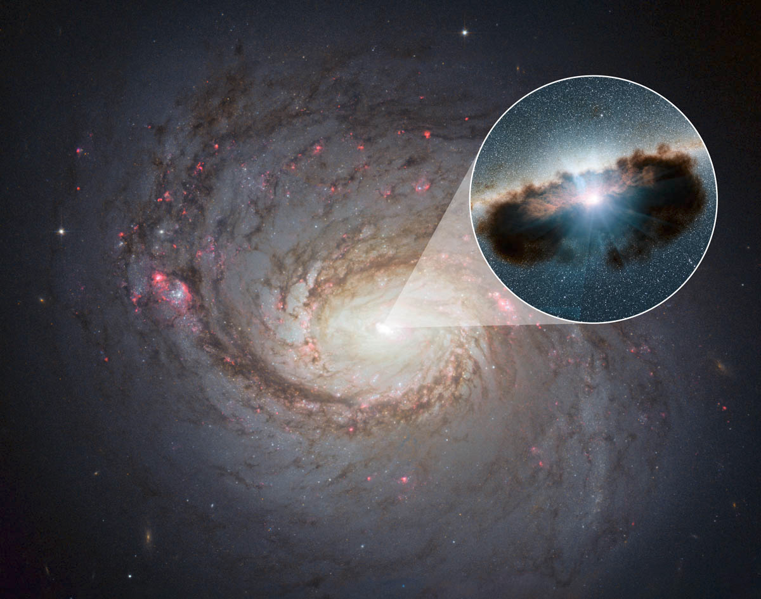
Marinucci+ 2016
We witnessed an unveiling event in the archetypal Compton-thick NGC1068!
A follow-up NuSTAR campaign is ongoing to constrain the variability timescales

Slide 8
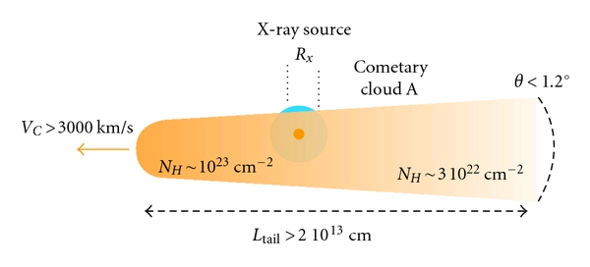
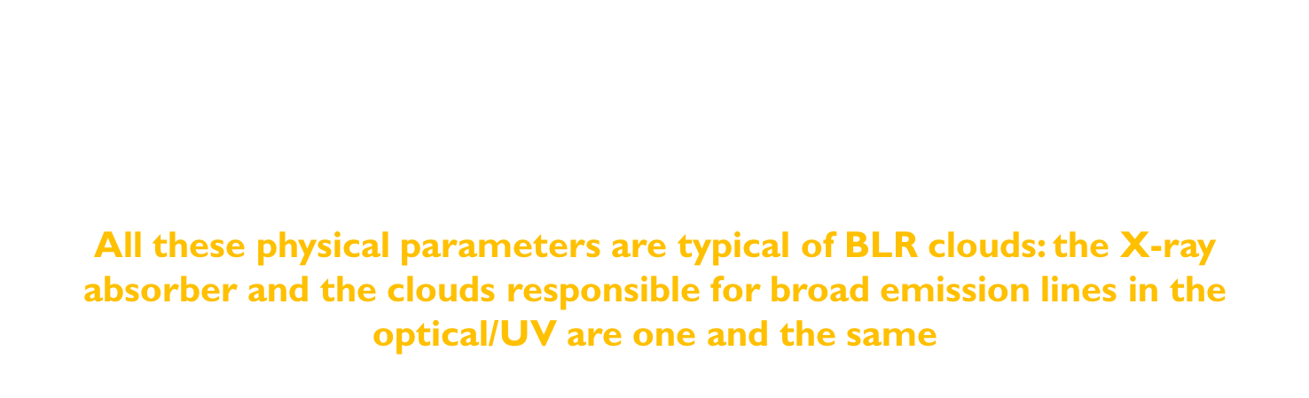
NGC 1365 shows absorption variability down to $∼10$hours: absorption is due to clouds with velocity $>103$km s⁻¹, at distances of $\sim 104$r_{g}. Their physical size and density are $\sim 1013$cm and $\sim 1010−1011$ cm⁻³
All these physical parameters are typical of BLR clouds: the X-ray absorber and the clouds responsible for broad emission lines in the optical/UV are one and the same
The obscuring clouds appear to have a “cometary” shape: a high-density head, and an elongated, lower-density tail
Maiolino+ 2010

Slide 9
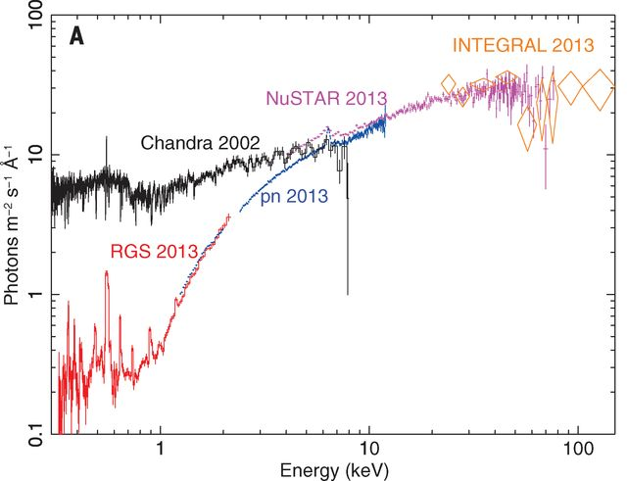
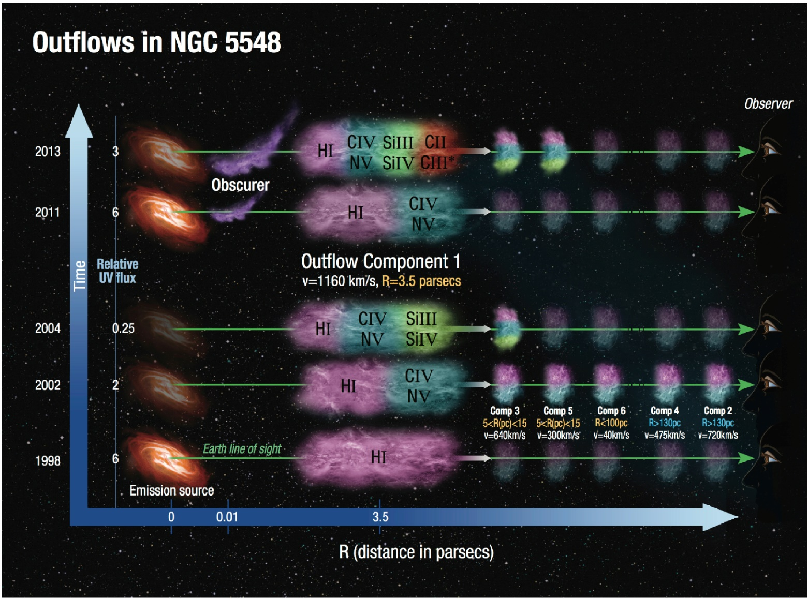
Such events are possible even in on-average unobscured sources
(e.g. Mrk 766: Risaliti et al. 2011; NGC5548: Kaastra et al. 2014)
Kaastra+ 2014
Arav+ 2015

Slide 10
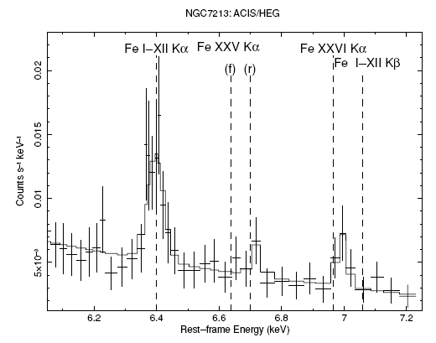
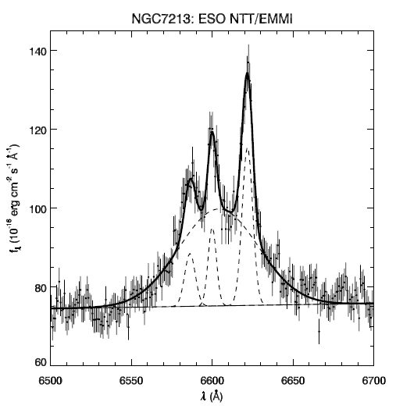

If the covering factor and the optical depth of the BLR are large enough, a significant fraction of the iron Kα emission line should be produced there
NGC 7213 has no Compton reflection (Bianchi et al. 2003, 2004, Lobban et al. 2010): the observed iron line cannot be associated to a Compton-thick material, like the torus or the disc
Simultaneous optical/X-ray (Chandra HEG) observations show that the FWHM of the iron line Kα and that of the Hα are both $\sim 2500$km/s
The iron Kα in NGC 7213 is produced in the BLR!
(see also NGC 2110: Marinucci et al 2015)
Bianchi+ 2008
High resolution X-ray spectroscopy with microcalorimeters (XARM, Athena) will be extremely powerful in tackling this issue

Slide 11
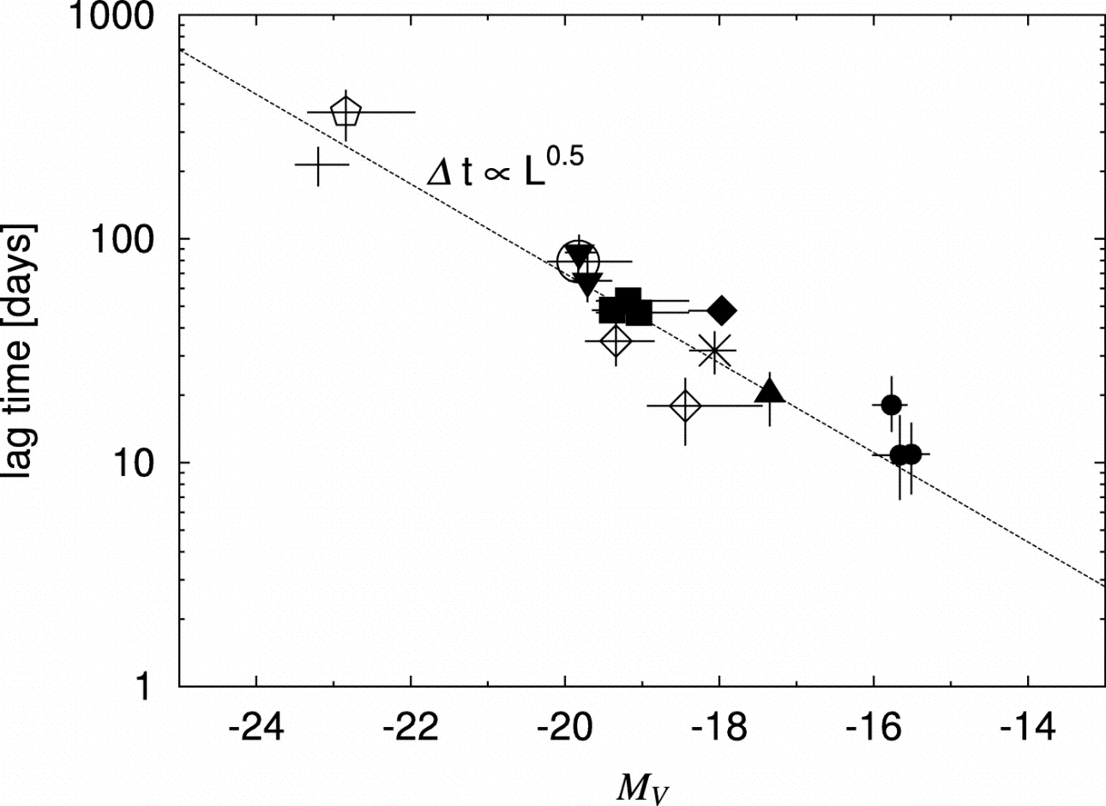

Absorption from pc-scale Tori
Early evidence for a circumnuclear dusty medium on (sub)parsec scales was obtained from near-IR studies, which revealed the presence of very hot dust, close to the sublimation temperature
(Storchi-Bergmann et al. 1992, Alonso-Herrero et al. 2001, Oliva et al. 1999)
Extensive reverberation observational campaigns also confirmed the expected $L^{1/2}$ dependence of the sublimation radius (Suganuma et al. 2006)
Suganuma+ 2006

Slide 12
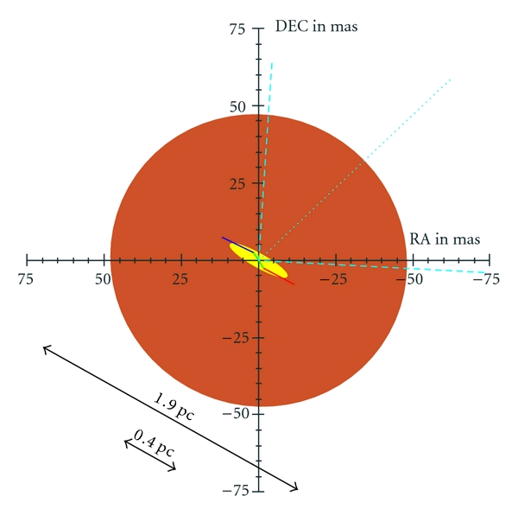

Mid-IR interferometry of NGC 1068 is consistent with a two-component dust distribution: an inner ($0.5$ pc) elongated hot ($T>800$K) component, and a more extended ($3−4$ pc), less elongated colder ($T\sim 300$K) component (Jaffe et al. 2004)
Most of the absorption is located outside $1$ pc
A similar result was found for Circinus: again two components, an inner and more compact ($0.4$ pc), and an outer ($2$ pc) component (Tristram et al. 2007)
Tristram+ 2007
No significant differences are found between type 1 and 2 sources and the size of the dusty emitter scales with the square root of the luminosity
(Tristram et al. 2009, 11; Kishimoto et al. 2011)
Tristram+ 2011

Slide 13
Compton-thick material with large covering factor is needed by the ubiquitous presence of the iron line and the Compton reflection component
(Perola et al. 2002; Bianchi et al. 2004, 2009)
The line, typically unresolved (FWHM < thousands km/s), must be produced far (BLR/torus/NLR). Current X-ray satellites resolve its FWHM only in a few objects and with limited information, leading to inconclusive estimates on its location
(Nandra 2006, Shu et al. 2011)
Shu+ 2011
Nandra 2006

Slide 14
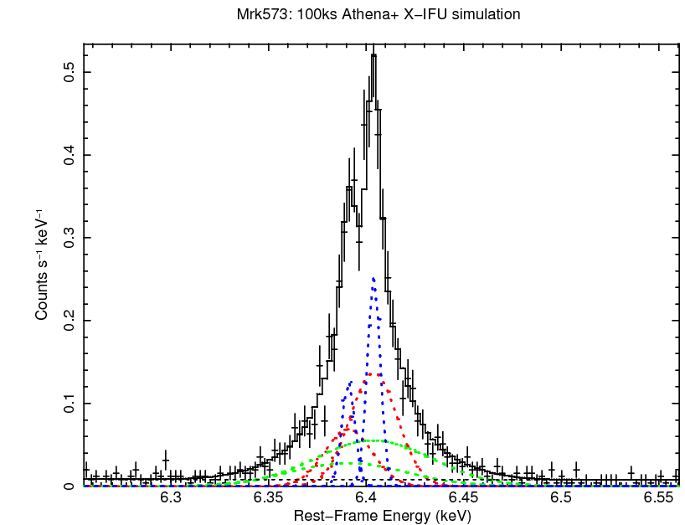
X-ray microcalorimeters (XARM, Athena) will represent a breakthrough, to deconvolve all the components of the iron line, as for the optical lines

Slide 15
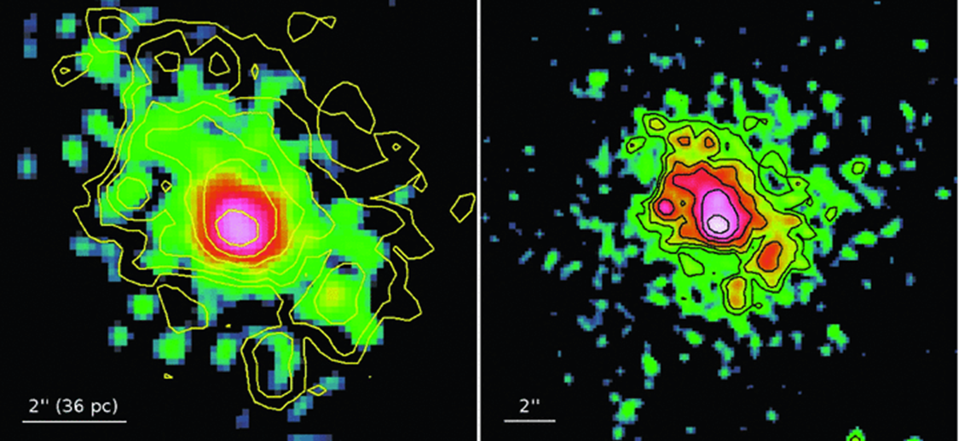

In NGC 4945 the iron line and reflection component are imaged, on projected scales of $∼200×100$pc
The central $30$ pc accounts for about $50\%$ of the whole emission
The structure is non-homogeneous, with visible clumps and empty regions with sizes of the order of tens of pc
Marinucci+ 2012, 2017
6.2-6.7 keV
3-10 keV
X-ray spectra of Compton-thick sources are completely dominated by reflection features, and they typically do not show any variability even on long time scales: the narrow iron line and the Compton reflection component are mostly produced on parsec-scale distance
In principle, the geometry and distance of the torus could be estimated by doing accurate X-ray reverberation analysis of the iron line and the Compton reflection component (possible with eXTP)

Slide 16
Absorption from gas in the Host Galaxy
The lowest column densities are consistent with the optical reddening in the host galaxy
Early evidence of obscuration by the host galaxy gaseous disk came from optically selected AGN samples, which avoid edge-on systems, confirmed by the SDSS survey
(Maiolino & Rieke 1995, Lagos et al. 2011)
Malkan+ 2008
Further direct evidence for obscuration on large scales was obtained through high-resolution HST images, showing that dust lanes at distances of hundreds of parsecs are very common in Seyfert galaxies
(Malkan et al. 1998)

Slide 17
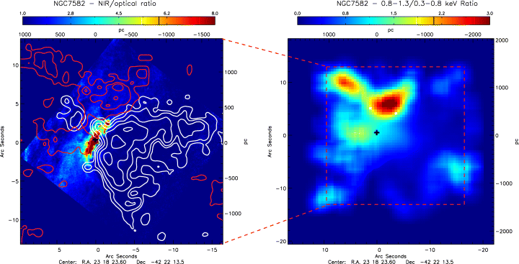
These structures are (indirectly) correlated with Compton-thin X-ray obscuration
(Guainazzi et al. 2005)
The effect of dust lanes can be also seen directly as X-ray obscuration towards the NLR soft X-ray emission
(Bianchi et al. 2007)
Bianchi+ 2007
The obscuration occurring on such large scales is limited by dynamical mass constraints, in order not to exceed the dynamical mass and have a covering factor large enough to account for the high number of observed Compton-thick sources: the bulk of the ubiquitous Compton reflection component and narrow neutral iron Kα line must come from a more compact region (Risaliti et al. 1999)

Slide 18

(Selected) Open Issues

Slide 19
True Type 2 Seyfert galaxies
About half of the brightest Seyfert 2 galaxies appear not to have hidden BLR in their optical spectra, even when high-quality spectropolarimetric data are analysed (Veilleux et al. 1997, Tran 2001)
They may be associated with inefficient (low covering factor/column density) or obscured mirrors (Heisler et al. 1997)
A stronger contribution/dilution from the host galaxy or from a circumnuclear starburst can also make the detection of polarized broad lines harder
(Alexander 2001, Gu et al. 2001)
A number of Sy2s without polarized broad lines may be genuine type 2 Seyferts: they intrinsically lack a BLR
Sy2s with polarized broad lines are more easily associated with truly obscured Sy1s, while Sy2s without polarized broad lines preferentially host weak AGN, possibly incapable of generating a classical BLR (Veilleux et al. 1997, Tran 2001)

Slide 20
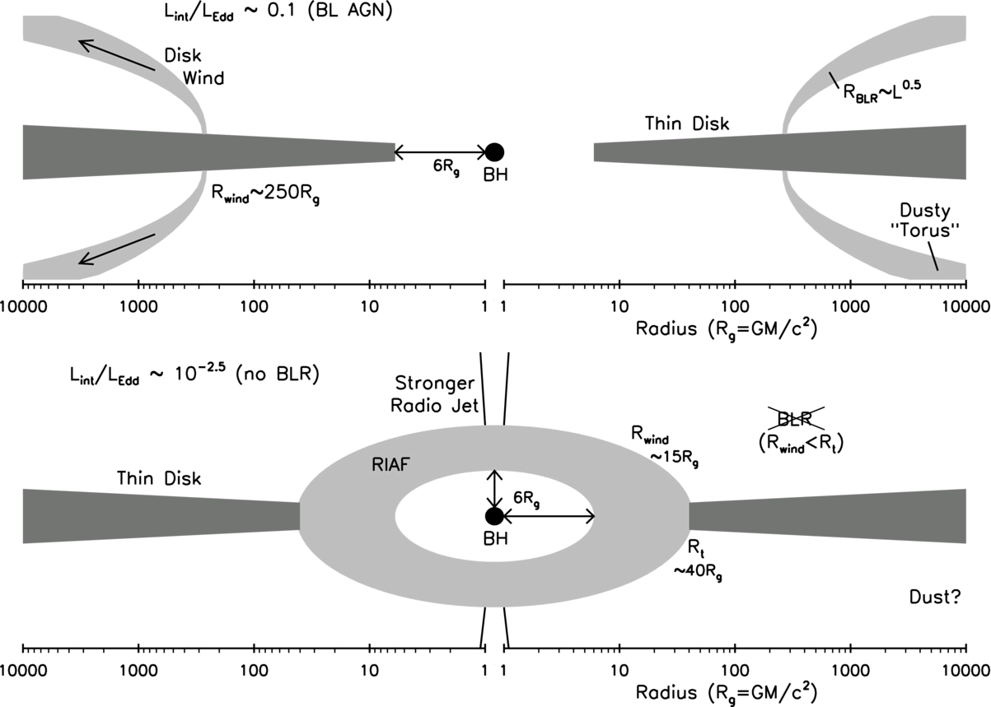
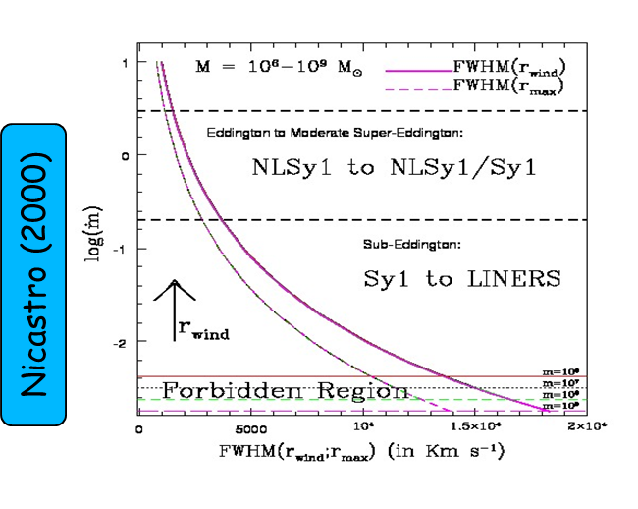

If the BLR is part of a disk wind, it cannot form if its launching radius falls below a critical radius: the innermost orbit of a classic Shakura & Sunyaev (1973) disk (Nicastro 2000), or the transition radius to a radiatively inefficient accretion flow (Trump et al. 2011)
No BLR forms for Eddington rates lower than a critical value
($\sim 2×{10}^{−3} M_{8}^{−1/8}$)
Nicastro 2000
Trump+ 2011

Slide 21
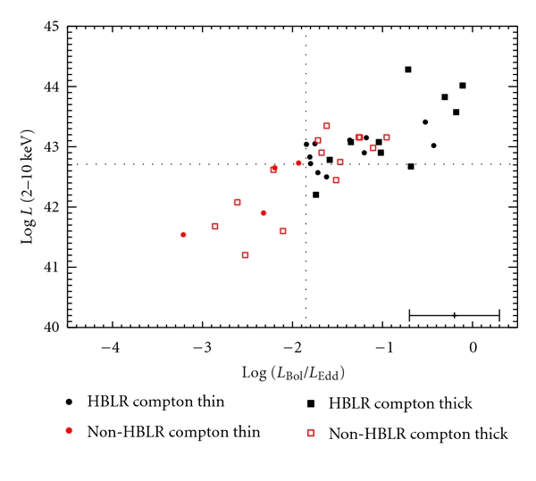

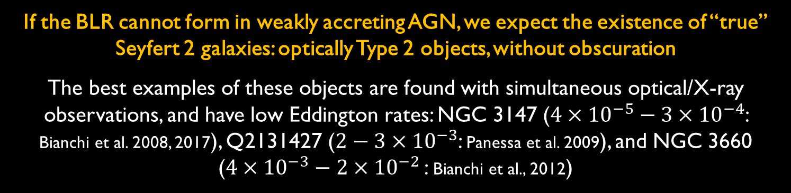
If the BLR cannot form in weakly accreting AGN, we expect the existence of “true” Seyfert 2 galaxies: optically Type 2 objects, without obscuration
The best examples of these objects are found with simultaneous optical/X-ray observations, and have low Eddington rates: NGC 3147 ($4×{10}^{−5}−3×{10}^{−4}$: Bianchi et al. 2008, 2017), Q2131427 ($2−3×{10}^{−3}$: Panessa et al. 2009), and NGC 3660 ($4×{10}^{−3}−2×{10}^{−2}$ : Bianchi et al., 2012)
Marinucci+ 2012
Broad optical lines are generally absent in the spectra in polarized light of Seyfert 2s with low Eddington rates
(Nicastro et al. 2003; Bian & Gu 2007;Wu et al. 2011)
The threshold in Eddington rate is generally found at $\sim 0.01$, both for optical/Xray surveys (Trump et al., 2011) and spectropolarimetric data (Marinucci et al., 2012)

Slide 22
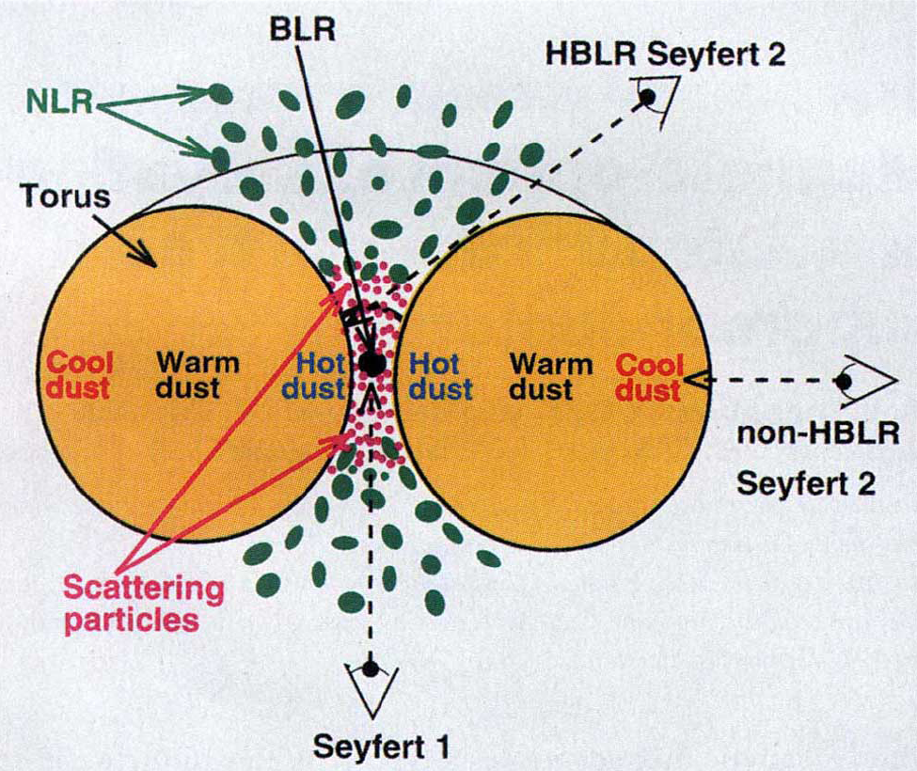
Below this threshold no broad lines are detected (either in total or polarized light), but above the threshold the BLR still cannot be detected in many Sy2s
These sources should possess a BLR, something prevents us from observing it: more inclined sources (with respect to the line of sight) should intercept a larger column density of the torus and may obscure the medium responsible for the scattering of the BLR photons (Shu et al. 2007)
Marinucci+ 2012
It appears that there are two classes of non-HBLR:
those with low accretion rates, really lacking the BLR,
those with higher accretion rate, likely hosting the BLR, but something prevents us from observing it
Heisler et al. 1997
Notes:
22

Slide 23
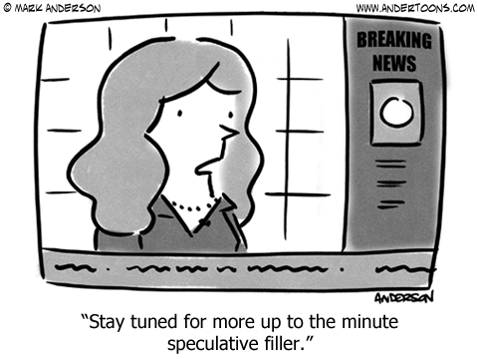

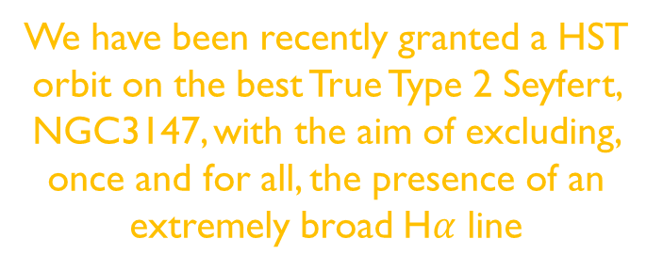
Are true type Seyfert 2s rare objects?
Few high SNR X-ray unobscured radio-quiet AGN (< 5%) lie below L_{bol}/L_{Edd}≃ $0.01$ (CAIXA: Bianchi et al. 2009)
Low-accreting unabsorbed Sy2 candidates rise up to $30\%$ in surveys (COSMOS: Trump et al. 2011), but it is difficult to say they are genuine true type 2 AGN. Similarly, $≃25\%$of low-accreting objects lack a hidden BLR in polarized light in obscured AGN (Marinucci et al. 2012)
We have been recently granted a HST orbit on the best True Type 2 Seyfert, NGC3147, with the aim of excluding, once and for all, the presence of an extremely broad H$α$ line

Slide 24
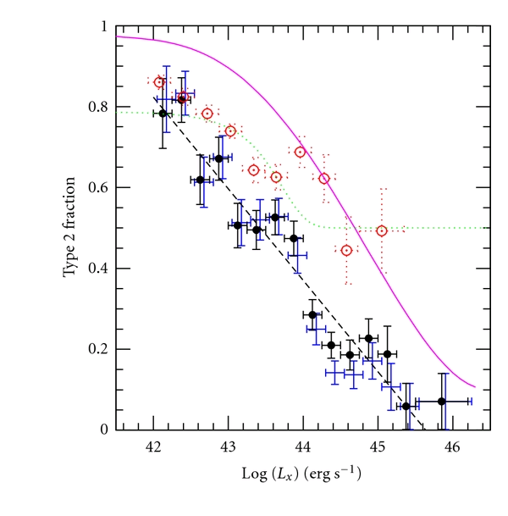
Luminosity Dependence of the Covering Factor
The covering factor of the obscuring medium shows a significant decrease with luminosity
This effect is present in various hard X-ray studies (Ueda et al. 2003, Steffen et al. 2003, La Franca et al. 2005, Akylas et al. 2006, Barger & Cowie 2005, Tozzi et al. 2006) and optical surveys (Simpson 2005), which have measured the relative fraction of obscured and unobscured AGN as a function of the bolometric luminosity
Hasinger 2008

Slide 25
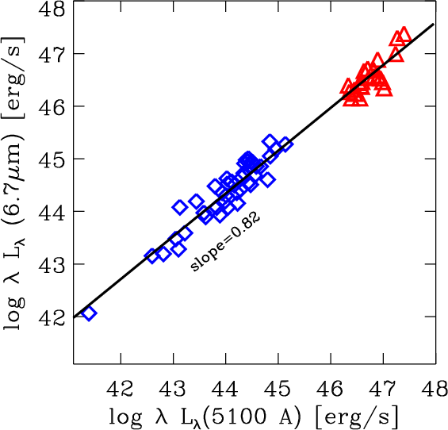
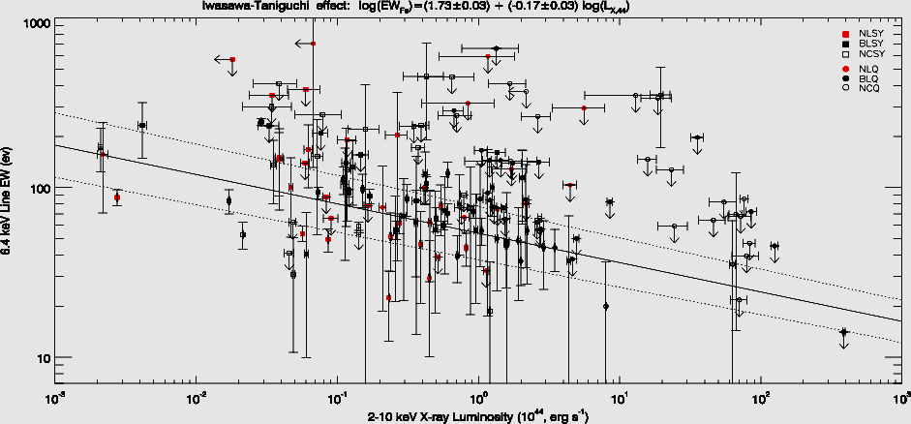
The ratio between the hot dust emission (near/mid-IR) and the primary AGN bolometric emission is proportional to the covering factor of the obscuring medium
Various studies have confirmed that the covering factor of the absorbing medium decreases as a function of luminosity
(Treister et al. 2008, Maiolino et al. 2007, Wang et al. 2005, Mor & Trakhtenbrot 2011)
Maiolino+ 2007
The EW of the (narrow) Fe Kα anti-correlates with luminosity (“Iwasawa-Taniguchi effect”), interpreted in terms of decreasing covering factor of the circumnuclear absorbing medium as a function of luminosity (Iwasawa & Taniguchi 1993, Page et al. 2004, Jiang et al. 2006, Guainazzi et al. 2006, Bianchi et al. 2007)
Bianchi+ 2007

Slide 26

Receding torus scenario (Lawrence 1991): higher luminosities imply larger dust sublimation radii and, if the torus has a constant height as a function of radius, a smaller covering factor of the dusty medium
This scenario cannot explain the decreasing covering factor inferred from X-ray studies, which do not trace the dusty component of the absorber
If the X-ray obscuration is due to interstellar gas, distributed in a rotationally supported disk on $\sim 100$pc (Lamastra 2006), its covering factor diminishes as the gravitational pull from the SMBH and the bulge increases with the BH mass (hence luminosity)
However, this model can explain the anti-correlation only for Compton-thin sources
The lower covering factor in luminous AGN can be a consequence of the stronger AGN radiation pressure impinging onto the circumnuclear medium and expelling larger fractions of material
In support of this scenario growing evidence for massive outflows in luminous AGN has been reported in the recent years

Slide 27
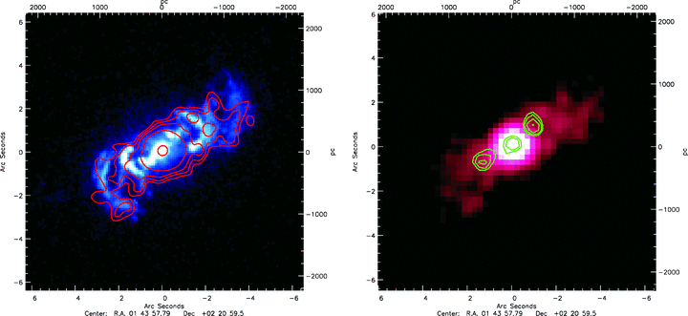
Disk-Torus Alignment
The most natural assumption on the geometry of the circumnuclear matter is that it is coaxial with the BH spin
This is an angular conservation argument: if they are all related to the inflowing material, the torus (and the collimated NLR), the accretion disk, the radio jet, and the BH spin should share the same axis
However, if the BH growth is due to multiple, unrelated accretion events, the BH spin may not reflect the rotation axis of the accretion disk. Another possibility is that the obscuring torus is not within the BH gravitational sphere of influence
Bianchi+ 2010
When large scales are imaged, the radio jet and the optical/X-ray NLR are generally in agreement with this simple picture
(Capetti et al. 1996, Bianchi et al. 2010)

Slide 28
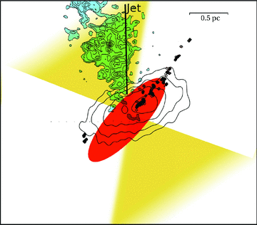
Mid-IR interferometric studies allow us to directly image the geometry of the torus with respect to the optical cones
In NGC1068 the torus and the ionization cones are misaligned!
(Raban et al. (2009)
The direction of the radio jet is also clearly tilted with respect to both the NLR and the torus
Similar analysis on other sources is clearly needed in order to shade some light on this issue
A promising, independent, method to test the torus/ionization cones misalignment is
X-ray polarimetry
(e.g. XIPE, IXPE, eXTP)
(Goosmann & Matt 2011)
[OIII]
Reconstructed
Ionization cone
H₂O Maser
Radio emission
Raban+ 2009
Torus
(IR interf.)

Slide 29
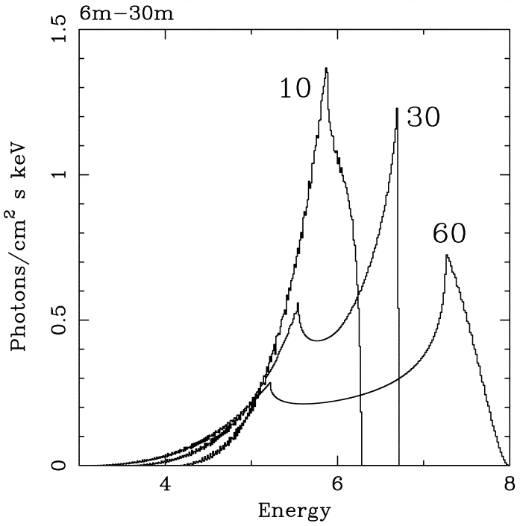
The inclination angle of the accretion disk can be estimated via the relativistic profile of iron lines produced in its inner regions
A simple relation between the inclination of the nuclear obscuring matter (as measured by the optical type) and that of the accreting matter should be ruled out (Guainazzi et al. 2011)
Fabian+ 2000
The distribution of the equivalent widths of the [OIII] emission line in a large sample of AGN is also not compatible with the presence of a torus coaligned with the accretion disk, unless the torus covering factor is extremely small
(Risaliti et al., 2011)
Guainazzi+ 2011

Slide 30
