Slide 1
Radiation Pressure Confinement in the X-ray Narrow Line Region of NGC1068
Stefano Bianchi
September 7th 2017 – The Power of X-ray Spectroscopy – Warsaw, Poland

Slide 2
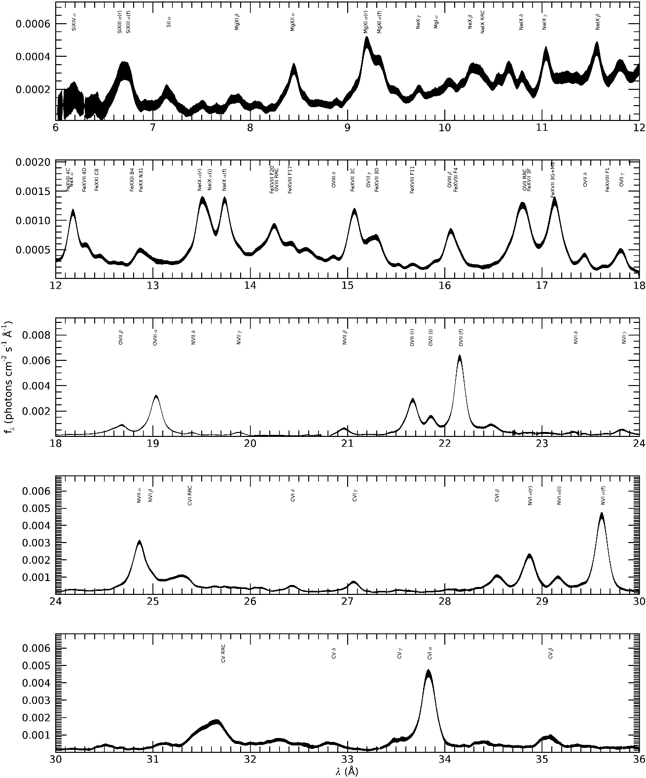
Soft X-ray Emission in Obscured AGN
Dominated by strong emission lines
with low or no continuum
Most of the ‘soft excess’ is concentrated in very strong lines easily detected even in very low SNR spectra
(e.g. Guainazzi & Bianchi, 2007)
Diagnostic ratios on triplets and
higher order series lines point to photoionization, with an important role of photoexcitation
(e.g. Kinkhabwala+ 2002, Guainazzi & Bianchi, 2007)
Bianchi+ prep.
NGC1068

Slide 3
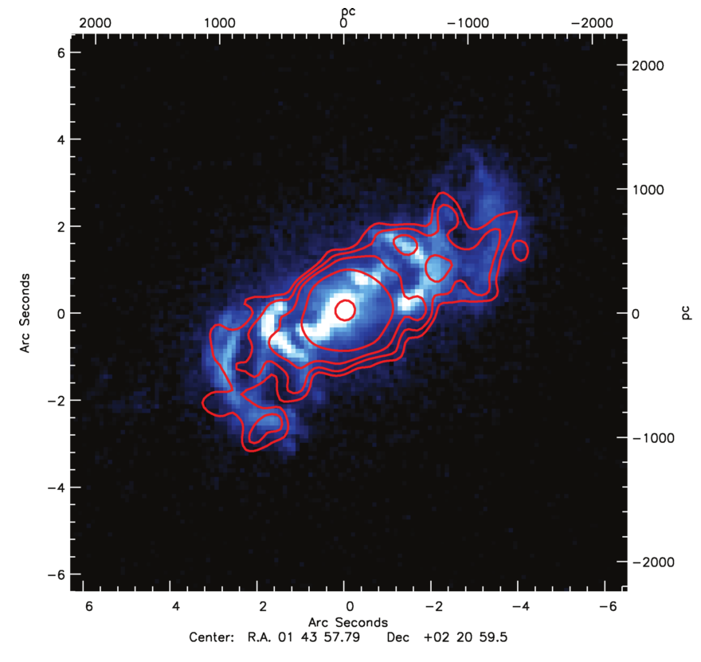
Bianchi+ 2010
Mrk573
The coincidence between the soft X-ray and [O iii] emission is striking in most sources observed by Chandra and HST, both in extension and in morphology (Bianchi+, 2006)
The same gas, photoionized by the AGN continuum, and extended on $\sim 100s$ pc, produces both the soft X-ray emission lines and the NLR optical emission
Inconsistent with a single-$U$ model → requires high-$U$ and low-$U$ phases
The [O iii]/soft X-ray ratio is spatially constant → $n∝r^{−2}$ (constant $U$)
The [O iii]/soft X-ray ratio is fairly universal among the sources

Slide 4
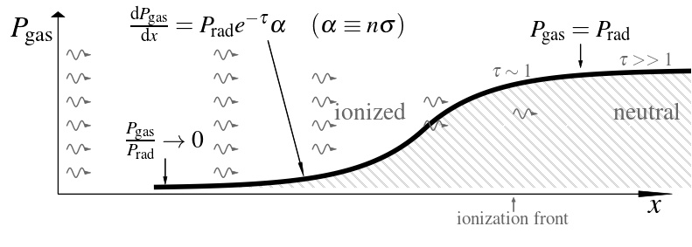
Mathews 67; Pier&Voit 95; Dopita+02; Różańska+06; Pellegrini+07,09; Draine 11;
Yeh&Matzner 12;Stern+14a,b; Baskin+14a,b
Radiation Pressure Confinement
Courtesy J. Stern
Assumptions
Radiation is the dominant force acting on the gas
The ambient pressure is much lower than radiation pressure
Consequences
The radiation is absorbed in the surface layer of the gas, both ionizing it and compressing it, thus increasing its pressure
The pressure of the incident radiation itself can confine the ionized layer of the illuminated gas: the gas is Radiation Pressure Confined

Slide 5
Mathews 67; Pier&Voit 95; Dopita+02; Różańska+06; Pellegrini+07,09; Draine 11;
Yeh&Matzner 12;Stern+14a,b; Baskin+14a,b
Radiation Pressure Confinement
Courtesy J. Stern
At $τ≫1$, all the radiation is absorbed, and there is a transition to neutral gas
At $τ∼1$, the gas pressure roughly equals the radiation pressure: this layer is called the ionization front
Near the ionization front, at the boundary between the H ii and H i layers, the temperature is always $T_{f}∼{10}^{4} K$, and the equality of gas pressure and radiation pressure implies that the ionization parameter is always $∼0.03$

Slide 6
Mathews 67; Pier&Voit 95; Dopita+02; Różańska+06; Pellegrini+07,09; Draine 11;
Yeh&Matzner 12;Stern+14a,b; Baskin+14a,b
Radiation Pressure Confinement
$P_{gas}↑,T↓ ⇒ n$ $↑↑, U↓↓$
Courtesy J. Stern
A large range of $n$ and $U$ in a single slab: the same gas which emits the low-ionization emission lines has a highly ionized surface which emits X-ray lines
At the ionization front, the temperature is universal and $P_{gas}=P_{rad}$: since the latter is $∝r^{−2}$, then $n∝r^{−2}$
The hydrostatic solution of RPC gas is independent of the boundary values at the illuminated surface ($U_{0}, n_{0}, P_{gas,0}$): RPC models are universal and have essentially zero free parameters

Slide 7
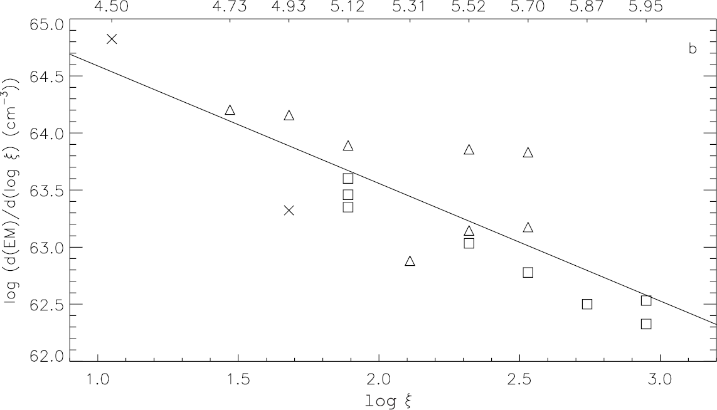
The expected Emission Measure Distribution from an RPC slab is (Stern+14):
$\frac{dL}{d\log{U} }∝U^{−0.9}$ (for $U>0.03)$
$$\frac{dL}{dlogU}∝U^{−1}$$
NGC1068
Ogle+ 2003
Can we go a step further and fit the soft X-ray high-resolution spectrum?

Slide 8
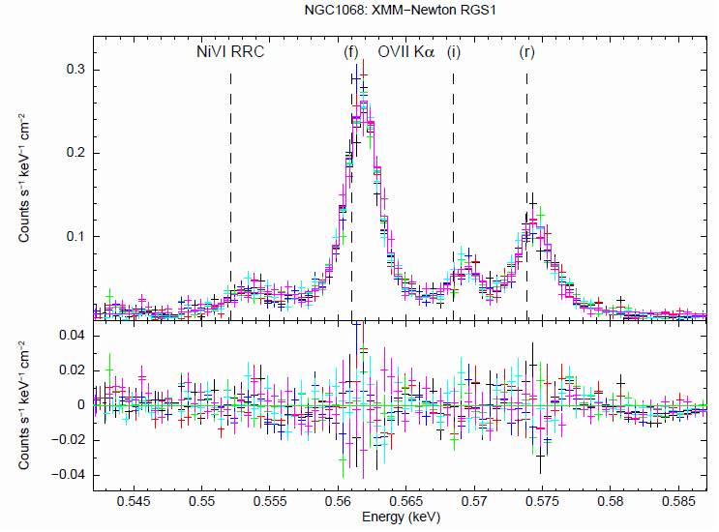
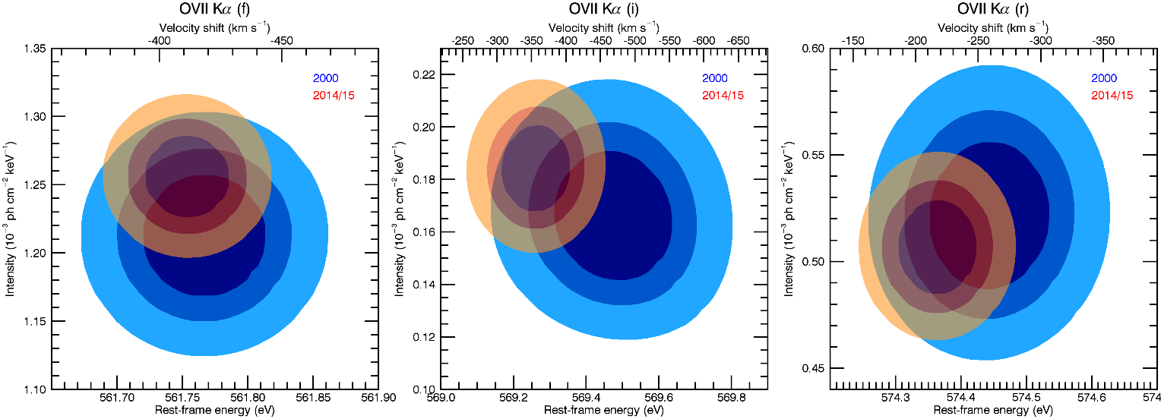
NGC1068 was observed by XMM-Newton twice in 2000 and four times in our extensive campaign in 2014/15 (Marinucci+ 2016)
No variability is found
The forbidden component of the O vii Kα line triplet is constant within $1\%$
Bianchi+ prep.

Slide 9
NGC1068
300ks RGS spectrum
Line and radiative recombination continuum emission from a broad range of ions and elements: from H-like and He-like low-Z ions (C to Si) up to Fe L-shell ions
Strong resonance lines point to the importance of photoexcitation as well as photoionization
A broad distribution in the logarithm of the ionization parameter is necessary: $2$ or more constant density slabs are needed, with different ionization
(Kinkhabwala+ 2002, Ogle+ 2003, Kallman+ 2014, Kraemer+ 2014)
Bianchi+ prep.

Slide 10
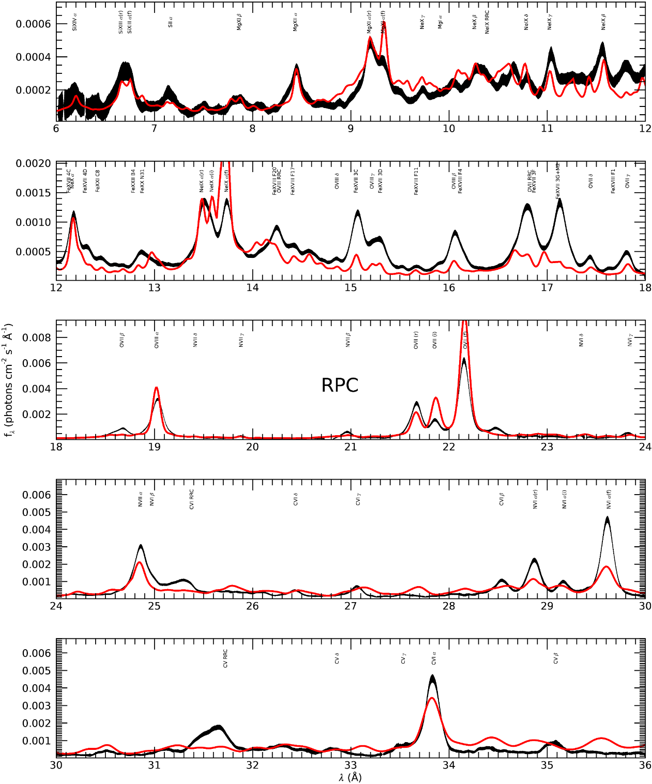
An RPC slab reproduces the observed broad range of ionization
This is NOT a fit!
No free parameters:
Insensitive to initial density ($\log{n_{0}}=1$)
Initial $ξ$ determines the existence of high ionization emission ($log ξ_{0}=4$)
Total column density determines the existence of the ionization front ($\log{N_{H}}=23$)
Bianchi+ prep.

Slide 11
(Significant) Issues
He-like triplets (O vii – Ne ix – Mg xi) ratios are not reproduced:
Resonant line too weak with respect to forbidden line: line transfer effects due to geometry? This would require very low $N_{H}$ for a constant density slab
The intercombination line is too strong: absorption by O vi (e.g. Mehdipour+ 2015)? Same issue for a constant density slab
Bianchi+ prep.

Slide 12
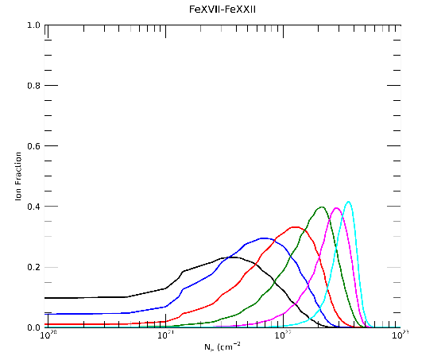
(Significant) Issues
Fe L lines are largely underestimated
but predicted iron ionization fractions are significant
Iron overabundance is also required to reproduce the neutral Fe K line, as well as He- and H-like Fe lines (Matt+ 2004)
Possibly incomplete atomic data (but Cloudy 17 is now linked to Chianti)
Bianchi+ prep.

Slide 13
(Significant) Issues
N vi is underestimated: overabundance?
Non-Solar abundances also required in constant density slabs (e.g. Kinkhabwala+ 2002, Ogle+ 2003, Kallman+ 2014, Kraemer+ 2014)
-C v RRC is very faint and the spectrum redwards $34 Å$ quite different: not sure what's going on there…
Bianchi+ prep.

Slide 14
Conclusions
The soft X-ray emission in obscured AGN is produced by a photoionized plasma, spatially coincident with the optical NLR
Radiation Pressure Confinement automatically reproduces all the most peculiar characteristics of this emission: a large range of $n$ and $U$ in a single slab,$n∝r^{−2}$, universal properties
We applied for the first time an RPC model to the high-resolution X-ray spectrum of an obscured AGN (NGC1068 – 300ks RGS)
The overall spectrum is well reproduced with no free parameters (!), in particular the broad range of emission from different ions and elements
Several significant issues are still open, and may be due to line transfer effects (geometry, turbulence, self-absorption) and non-Solar abundances

