Slide 1



Photoionization instability of winds in X-ray binaries
Stefano Bianchi
June 30th 2017 – European Week of Astronomy and Space Science – Prague, Czech Republic

Slide 2
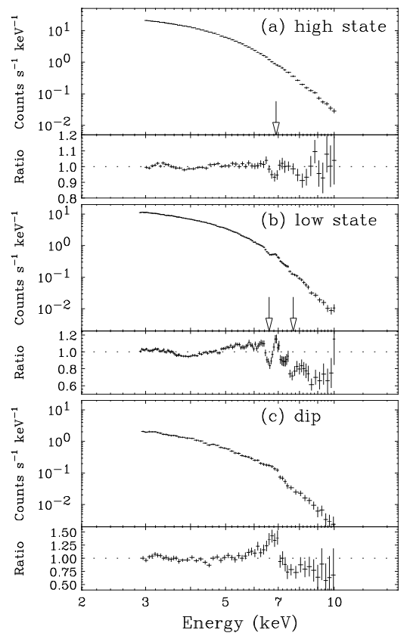
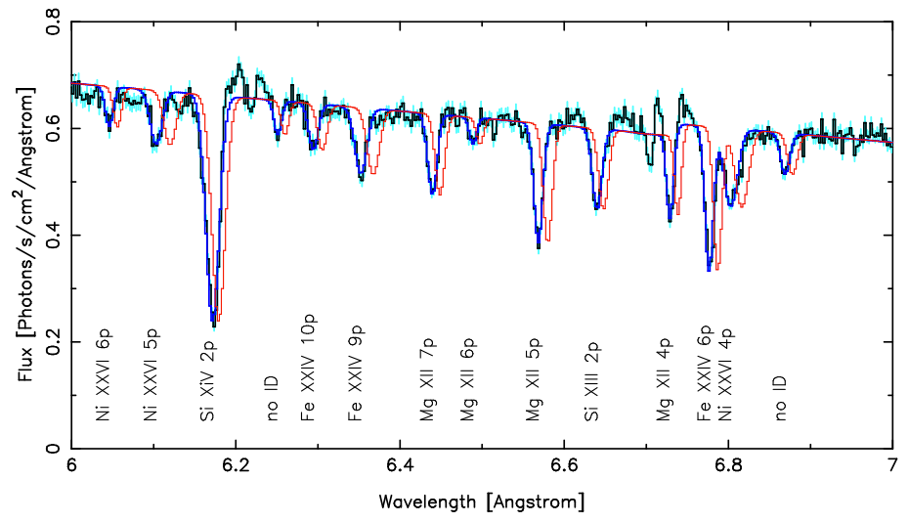
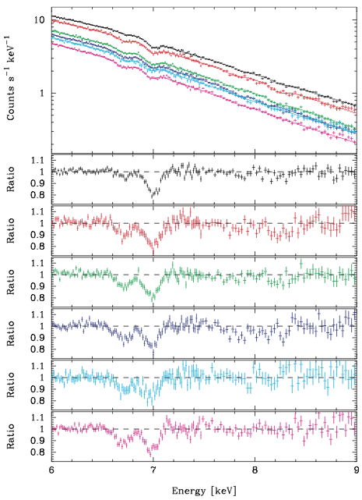
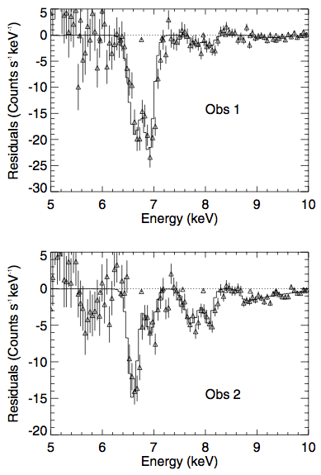
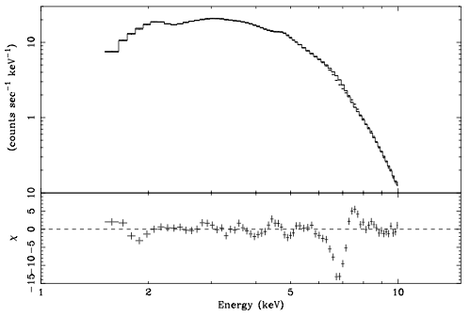
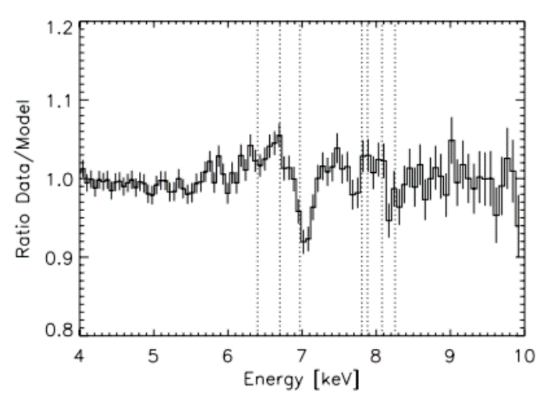
4U1630-472
GROJ1655-40
Suzaku
GROJ1655-40
Chandra
ASCA
Winds in GBHs
Miller+ 06
GROJ1655-40
XMM
Kubota+ 07
Ueda+ 98
GRS1915+105
GX 13+1
ASCA
XMM
Diaz-Trigo+ 07
Diaz-Trigo+ 12
Kotani+ 00

Slide 3
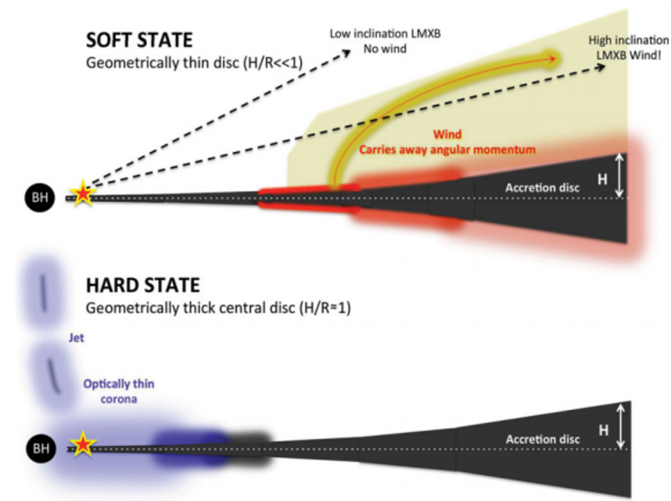
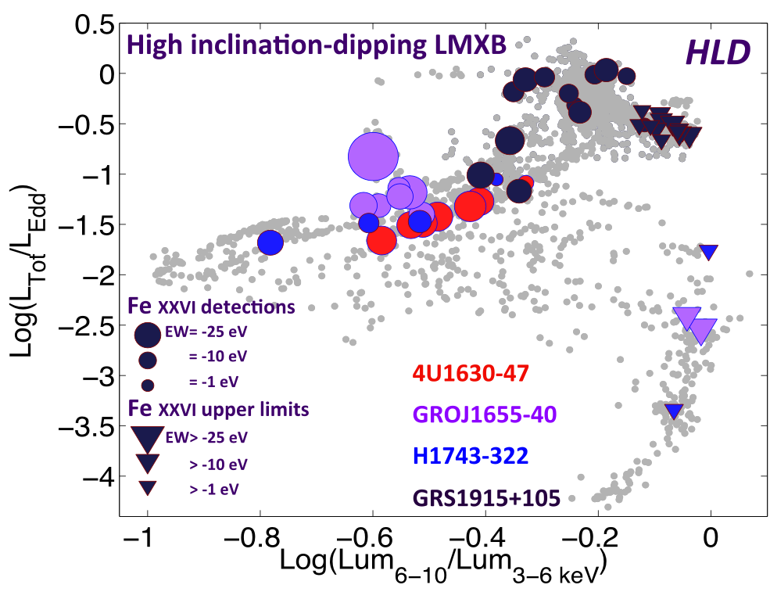
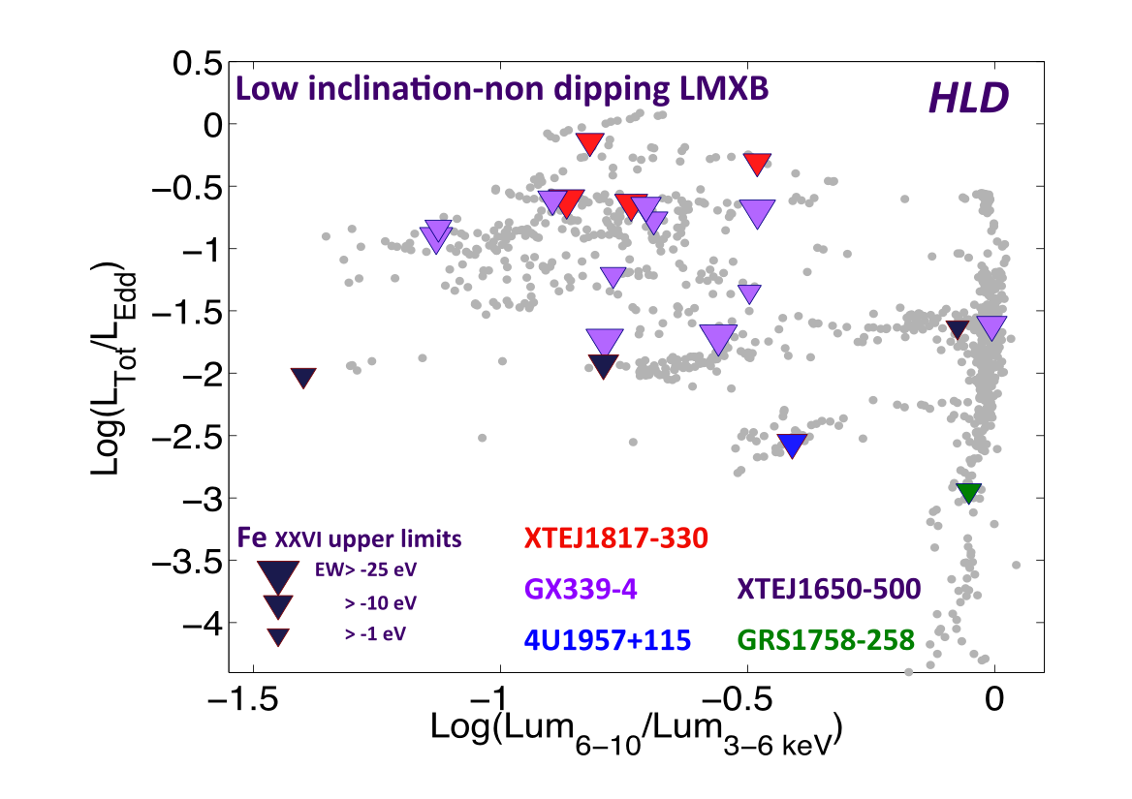
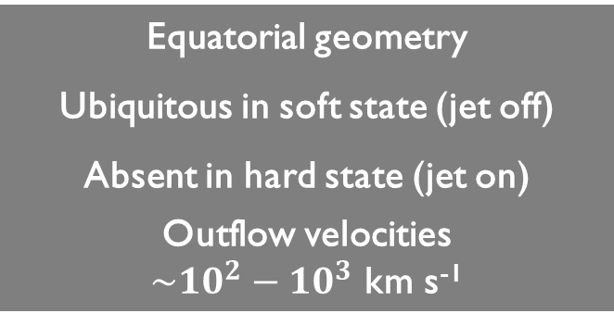
Equatorial geometry
Ubiquitous in soft state (jet off)
Absent in hard state (jet on)
Outflow velocities
$\sim 10^{2}−10^{3}$ km s⁻¹
Winds in GBHs
Ponti+ 12
Ponti+ 12

Slide 4
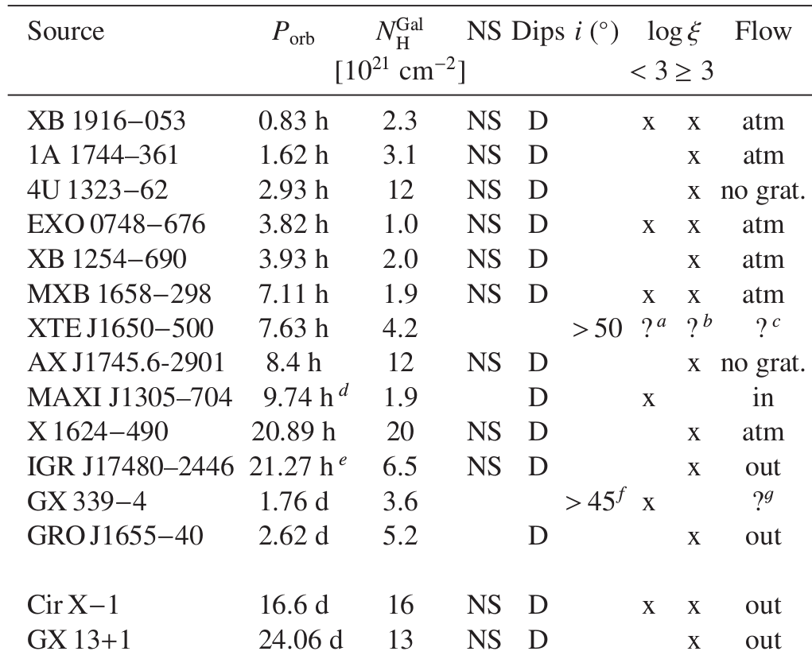
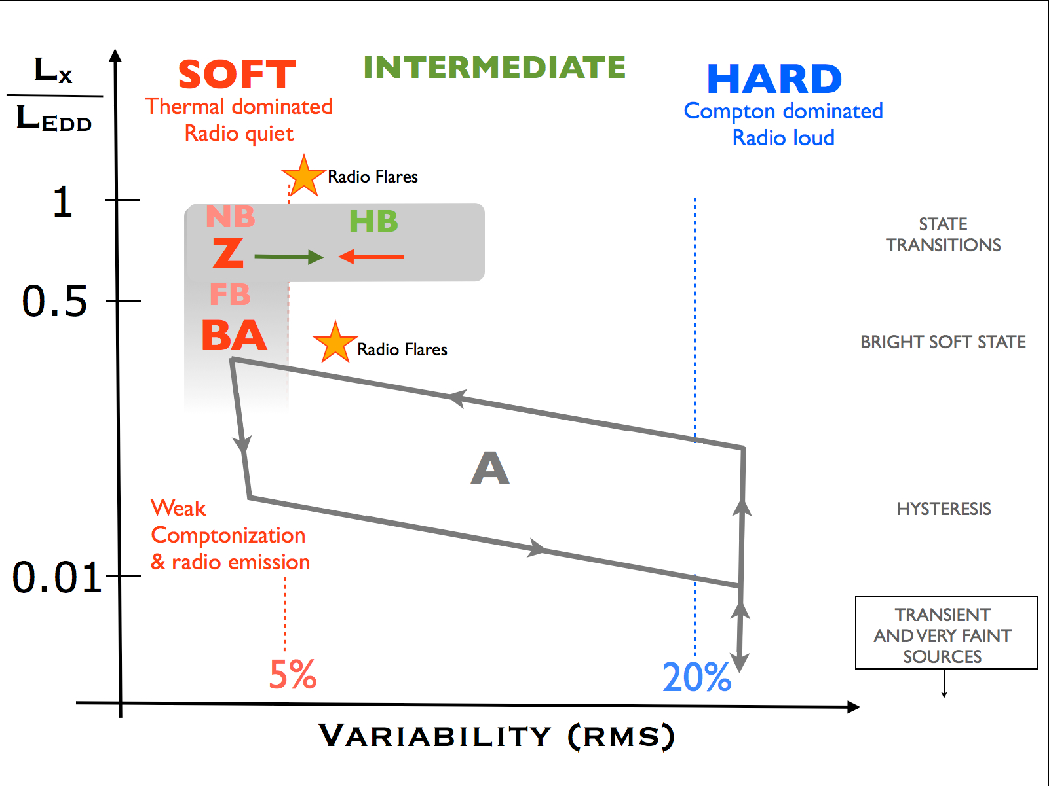

Díaz Trigo & Boirin 16
Equatorial geometry
Outflow velocities:
$\sim 10^{2}−10^{3}$ km s⁻¹ (winds)
$\sim 0$ km s⁻¹ (disc atmospheres)
Winds in NS LMXBs
State (jet) connection?
NSs LMXBs fit in the canonical state scheme of BH systems: variability is the key for classification
Only two sources have extensive monitoring campaigns
Muñoz Darías+ 14

Slide 5
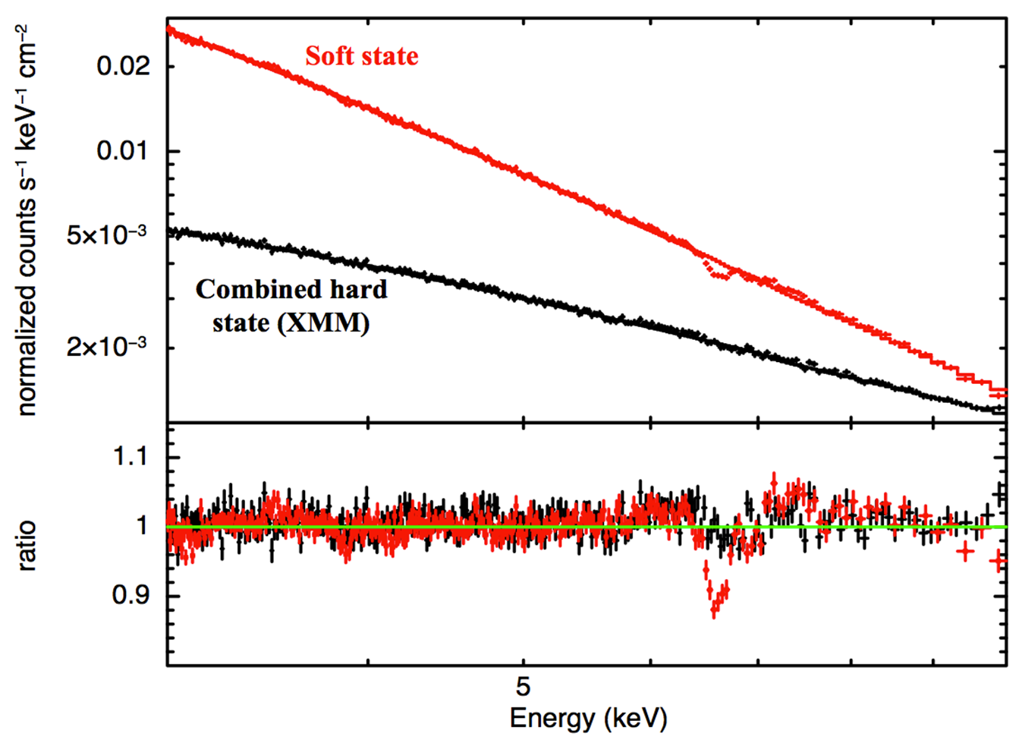
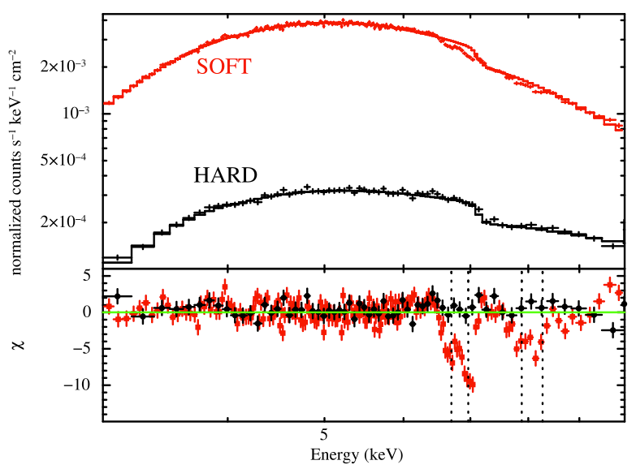
In the two best monitored NS systems, the wind is present only in the soft states, and always disappears in the hard states
EXO 0748-676
Ponti+ 14
The connection between Fe K absorption and states is a general characteristic of accreting sources
AX J1745.6-2901
Ponti+ 15

Slide 6
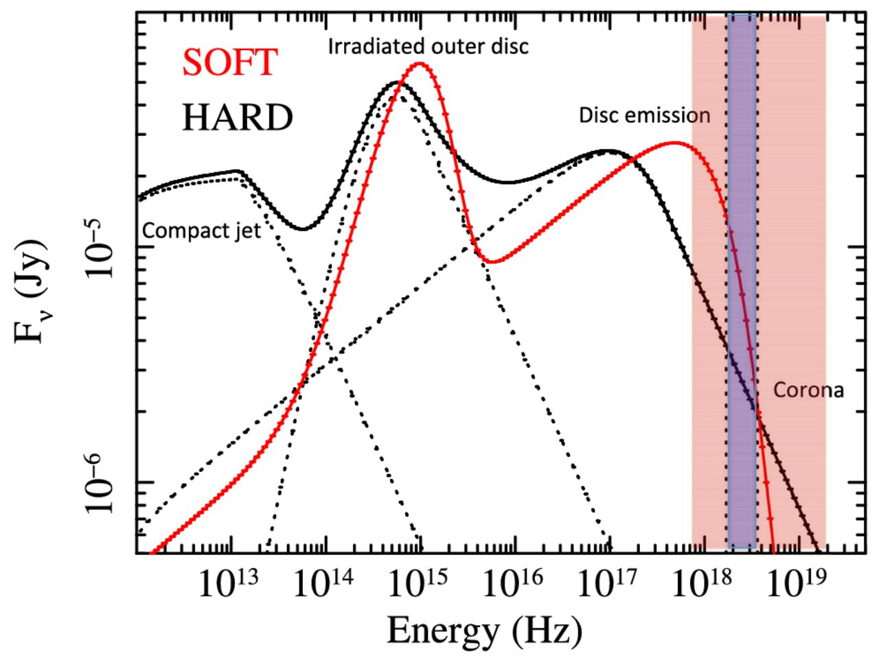
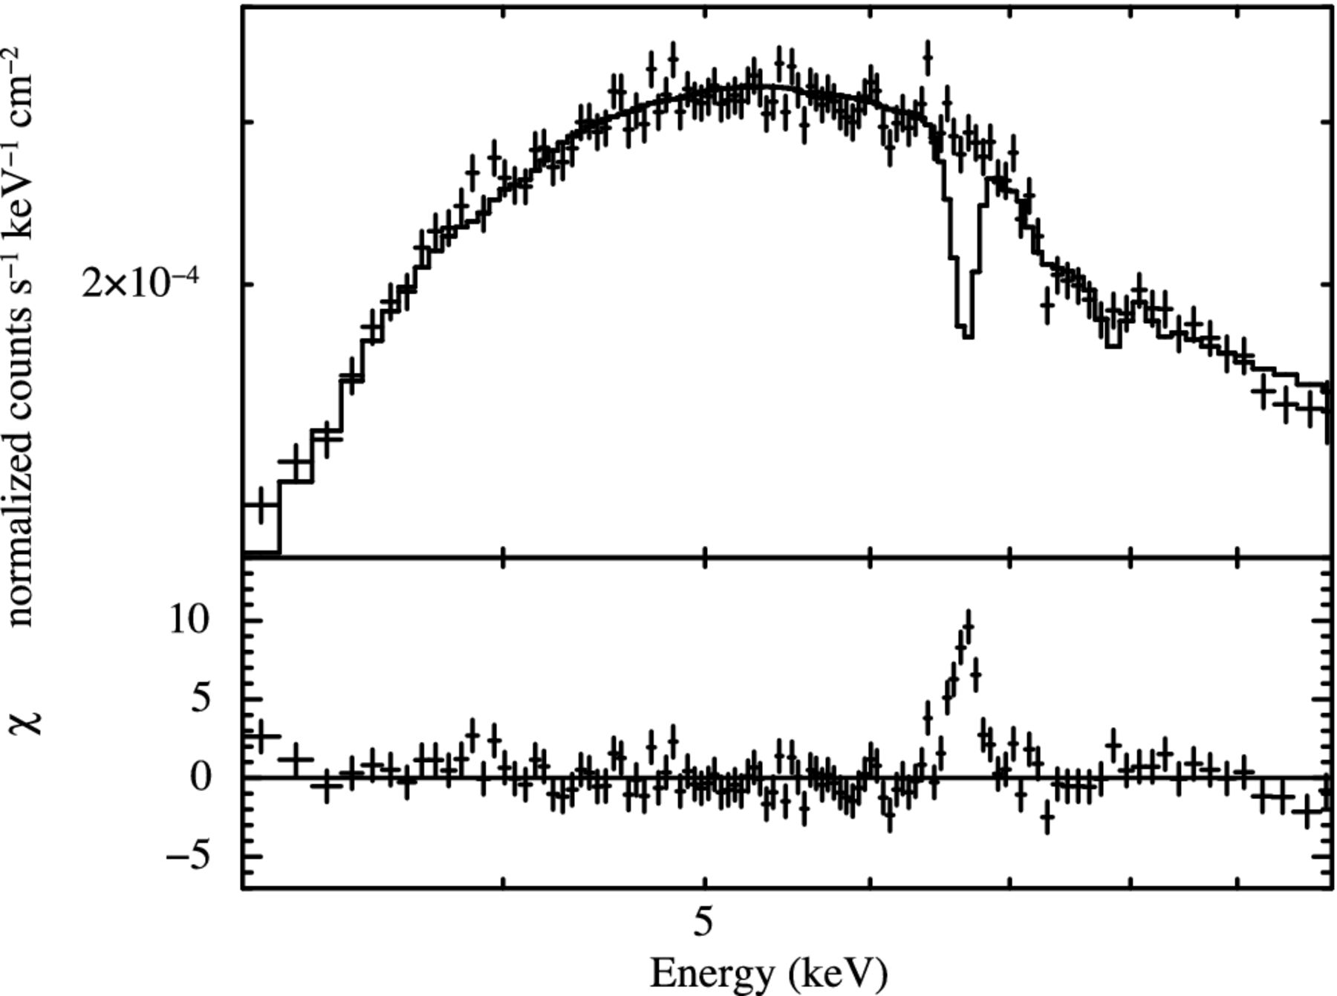

AX J1745.6-2901
XMM + NuSTAR
The SEDs are modelled by a multi-colour disc emission (dominant in the soft state) and a powerlaw arising from Comptonization of its seed photons (dominant in the hard state)
The optical and infrared band of the SEDs are due to emission from the irradiated disc
The contribution at radio-to-infrared frequencies from a compact jet is only added in the hard state
Ponti+ 15
If the wind retains its physical properties ($nr^{2}=const$) in the hard states, it would remain detectable with the available observations
Fe K absorption does not disappear because of over-ionization in the hard state

Slide 7
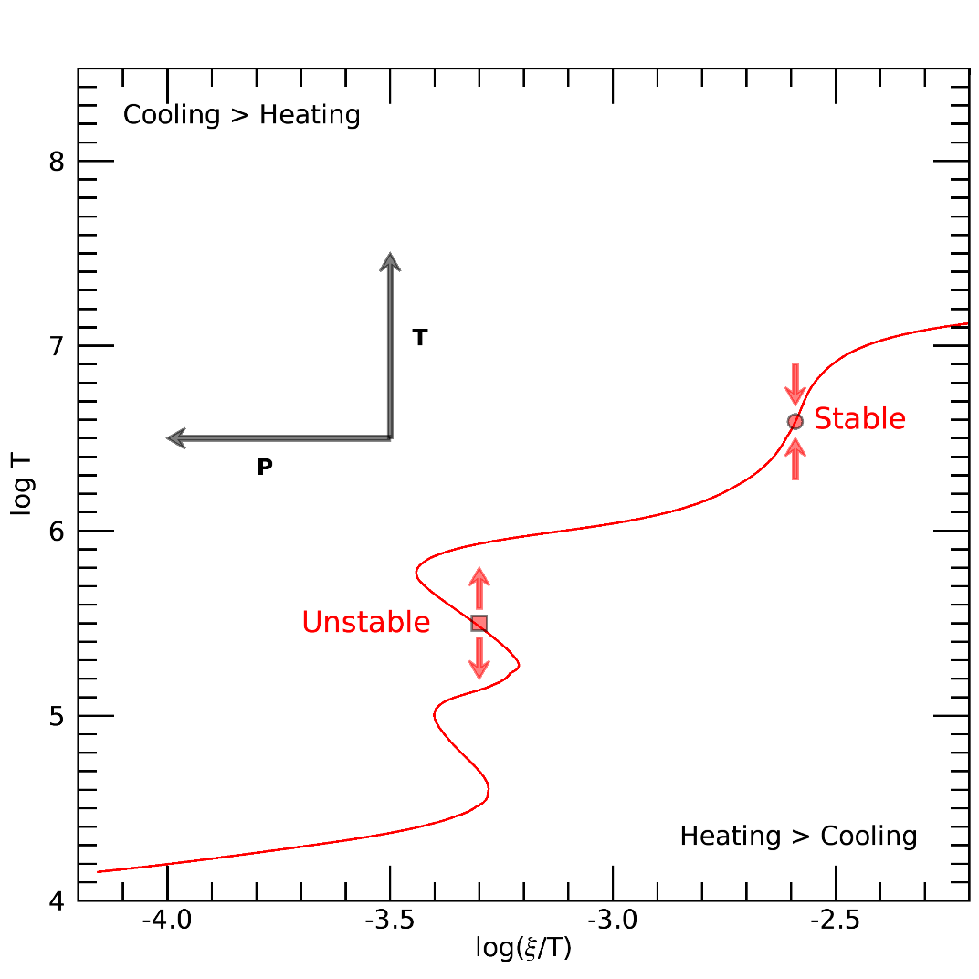
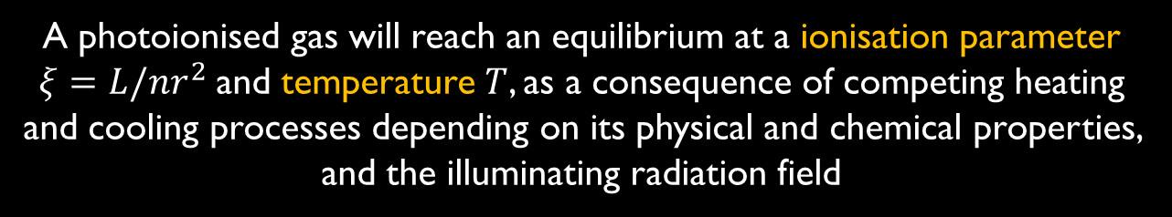

A photoionised gas will reach an equilibrium at a ionisation parameter $ξ=L/nr^{2}$and temperature $T$, as a consequence of competing heating and cooling processes depending on its physical and chemical properties, and the illuminating radiation field
These equilibrium states can be drawn in a stability curve, where
$$\frac{ξ}{T}∼\frac{L}{{nTr}^{2}}∼\frac{1}{p}$$
An equilibrium state where the slope of the curve is positive is thermally stable
If the slope of the stability curve is negative, the state is thermally unstable and is likely to collapse into a different stable equilibrium state

Slide 8
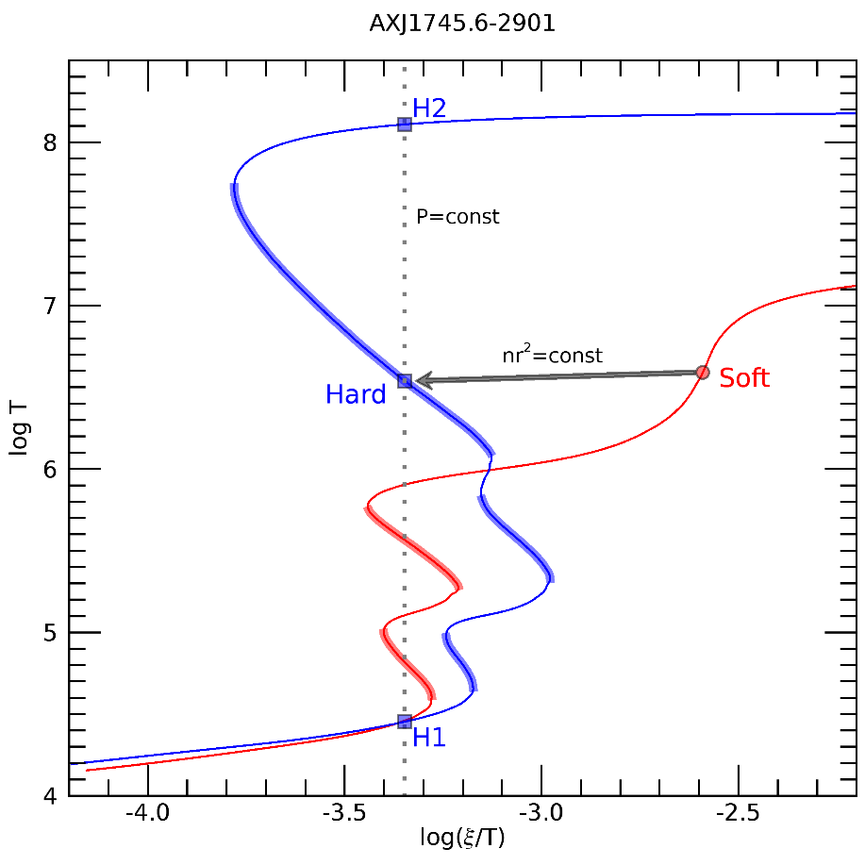
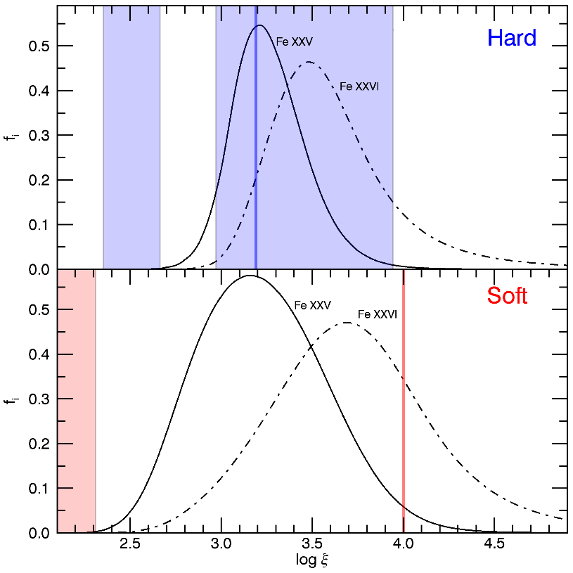
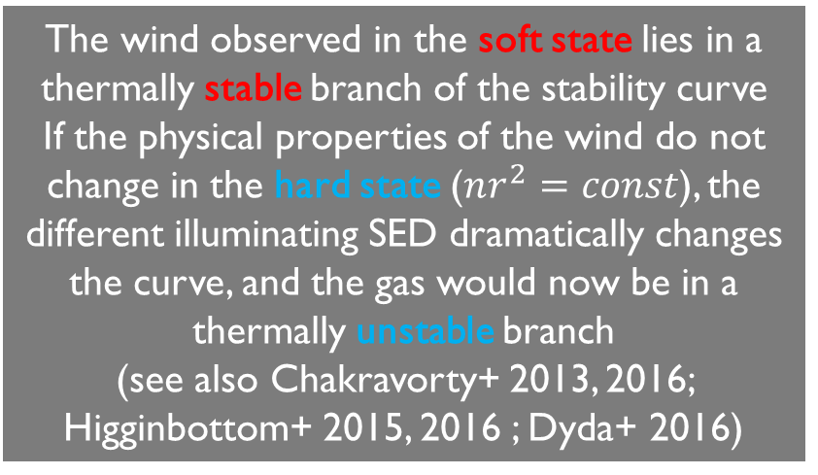
Bianchi+ in prep.
The wind observed in the soft state lies in a thermally stable branch of the stability curve
If the physical properties of the wind do not change in the hard state ($nr^{2}=const$), the different illuminating SED dramatically changes the curve, and the gas would now be in a thermally unstable branch
(see also Chakravorty+ 2013, 2016; Higginbottom+ 2015, 2016 ; Dyda+ 2016)
Bianchi+ in prep.
All the ionisation parameters dominated by Fe xxv and Fe xxvi are in a stable branch of the stability curve in the soft state, while they are all in unstable branches for the hard state: the absorption features are expected to disappear, as observed

Slide 9




Toy Model
Static cloud ($v=0$) at distance $r$, not replenished
After the transition from the soft to the hard state, the gas instantaneously moves to the new equilibrium state (recombination, ionization and thermal time-scales are less than tens of seconds): $n$ and $r$ can be assumed constant
Bianchi+ in prep.
The new equilibrium state is unstable, and any perturbation will make the gas migrate to a stable solution in few hours (dynamical time-scale)
Assuming that $r$ will not change in this time-scale, the new stable equilibrium will be characterized by different values of $T$, $ξ$, and $n$

Slide 10



Toy Model
Static cloud ($v=0$) at distance $r$, not replenished
In the hard state, several phases of the gas can coexist in pressure equilibrium
For an isobaric displacement from the initial unstable solution, we have two stable solutions:
$H1$ (cold, high density) and $H2$ (hot, low density)
Bianchi+ in prep.
There is no easy way to predict which stable solution the plasma will choose: hot and cold clumps can coexist adopting an unknown geometry, or a hot, dilute medium may confine cold, denser clumps, and a part of the cold phase may continuously evaporate to the hot phase and vice-versa in a dynamical time-scale
$logξ_{H2}=4.$76
$T_{H2}=1.3×{10}^{8}$ K
$$n_{H2}=2.7×{10}^{10} cm^{−3}$$
$$logξ_{H1}=1.10$$
$T_{H1}=2.8×{10}^{4}$ K
$$n_{H1}=1.2×{10}^{14} cm^{−3}$$

Slide 11
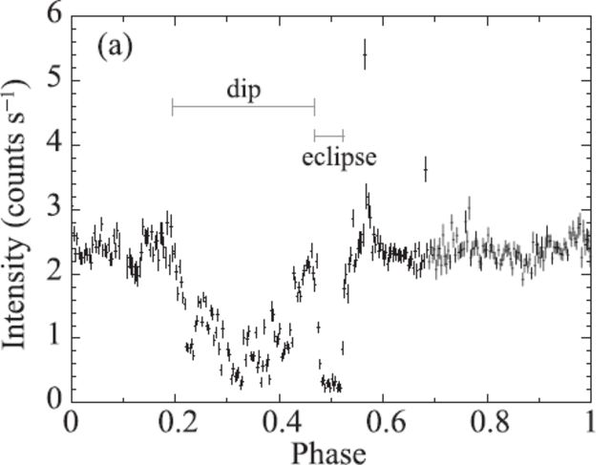


Toy Model
Static cloud ($v=0$) at distance $r$, not replenished
The hot phase has a very high ionization parameter, corresponding to negligible fractions of Fe xxv and Fe xxvi: this component of the wind will become unobservable
The cold phase is substantially neutral
If $logN_{H}=23.5$ (as for the wind in the soft state), this would absorb the X-ray emission up to $\sim 3$ keV
Incidentally, this value is the same as the neutral column density observed in AXJ both in the hard and in the soft state, so it would be only observed as a change of the persistent neutral absorption
Any connection with the dips?
Hyodo+ 09
$logξ_{H2}=4.$76
$T_{H2}=1.3×{10}^{8}$ K
$$n_{H2}=2.7×{10}^{10} cm^{−3}$$
$$logξ_{H1}=1.10$$
$T_{H1}=2.8×{10}^{4}$ K
$$n_{H1}=1.2×{10}^{14} cm^{−3}$$

Slide 12


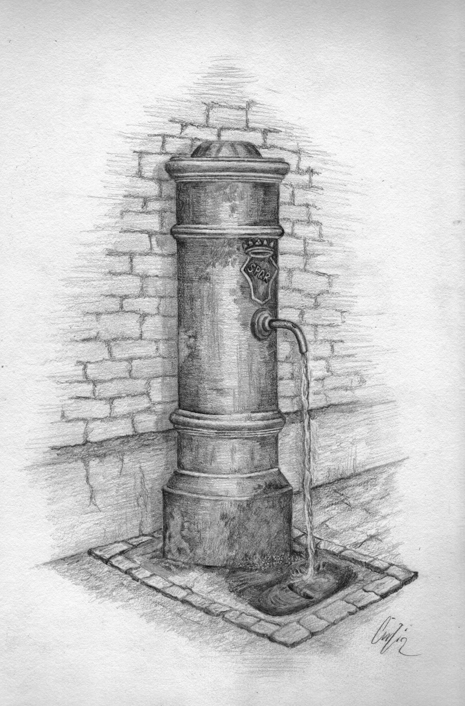
From a Toy Model to the ‘Real’ World
A simple toy model explains the disappearance of Fe absorption in the hard state because of instability, but:
-A cold phase in the hard state is expected: is it observed?
-A static disk atmosphere is still in agreement with data in AXJ, but in other sources outflowing winds need a continuous replenishment
$logξ_{H2}=4.$76
$T_{H2}=1.3×{10}^{8}$ K
$$n_{H2}=2.7×{10}^{10} cm^{−3}$$
-With the same assumptions, we should come back to the initial wind passing from hard to soft (as observed). The hot phase will remain transparent, while the cold phase would not be ionized enough to produce Fe absorption
A ‘fountain’ is needed to re-launch the wind!
The launching mechanism must change from the soft to the hard state (see e.g. Chakravorty+ 2016)
If the plasma is the disc atmosphere, we automatically introduce a mechanism that re-creates it in the soft state
$$logξ_{H1}=1.10$$
$T_{H1}=2.8×{10}^{4}$ K
$$n_{H1}=1.2×{10}^{14} cm^{−3}$$

Slide 13

Photoionization instability of winds in X-ray binaries (in a Slide)
Equatorial winds are ubiquitous in LMXBs
The connection between Fe K absorption and states is a general characteristic of accreting sources
Fe K absorption does not disappear because of over-ionization in the hard state
A simple toy model explains the disappearance of Fe absorption in the hard state because of photoionization instability
A cold phase in the hard state is expected: is it connected to dips?
Outflowing winds need a continuous replenishment
The toy model cannot reproduce the wind back to the soft state
A ‘fountain’ is needed to re-launch the wind!
The launching mechanism must change from the soft to the hard state

Slide 14
EXTRA SLIDES

Slide 15
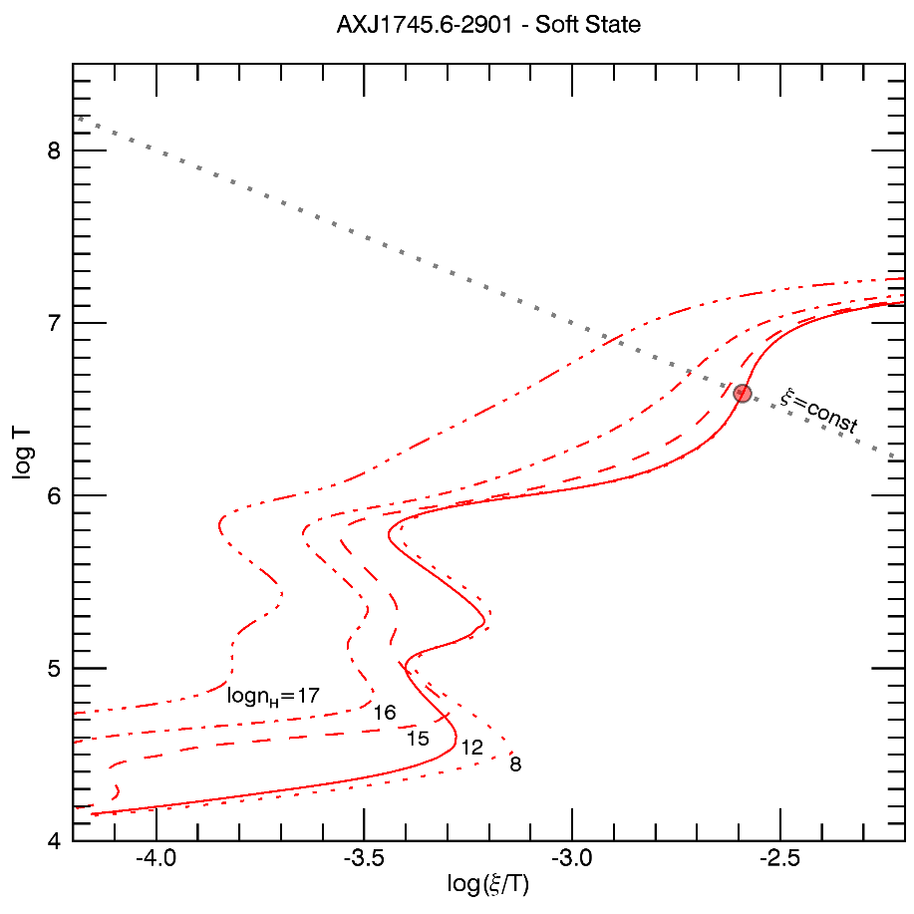
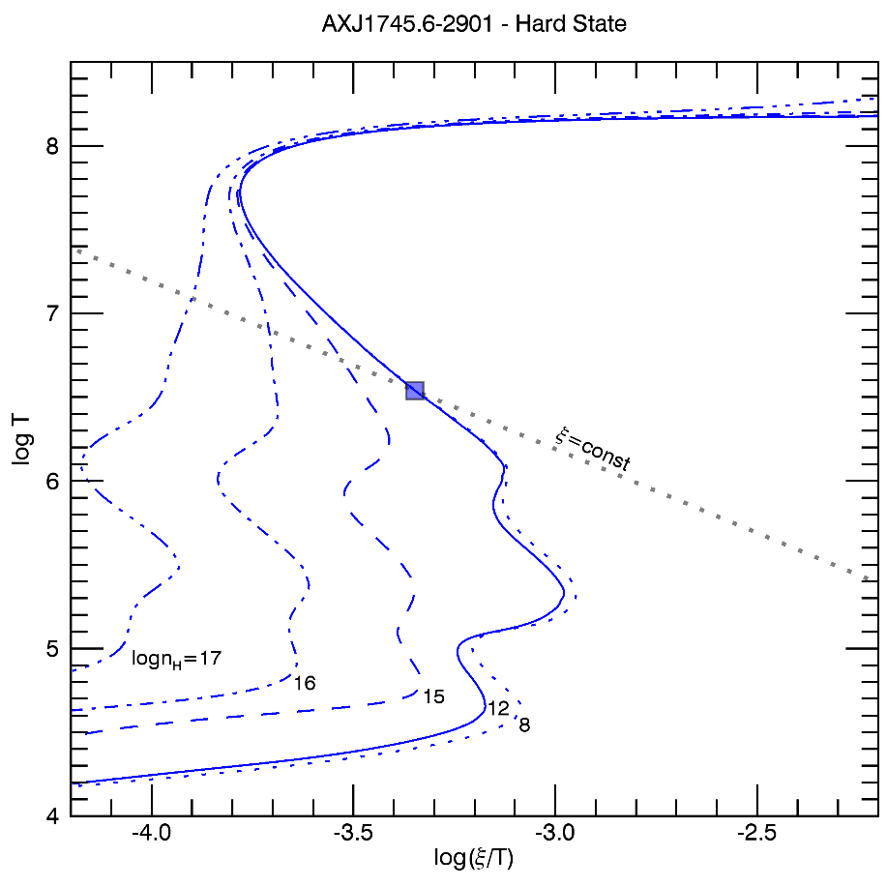
Density Dependence

Slide 16
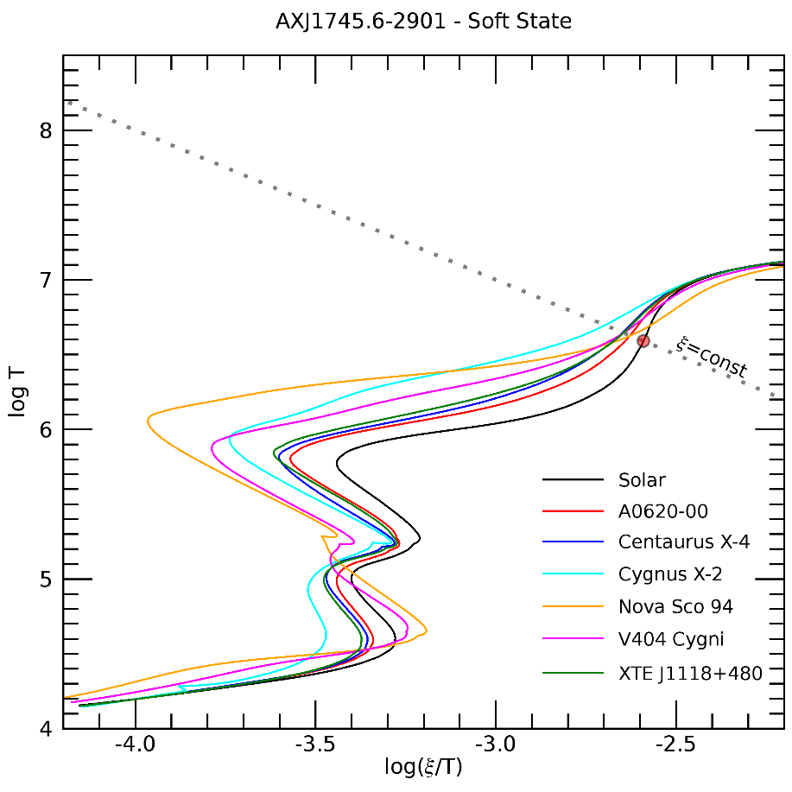
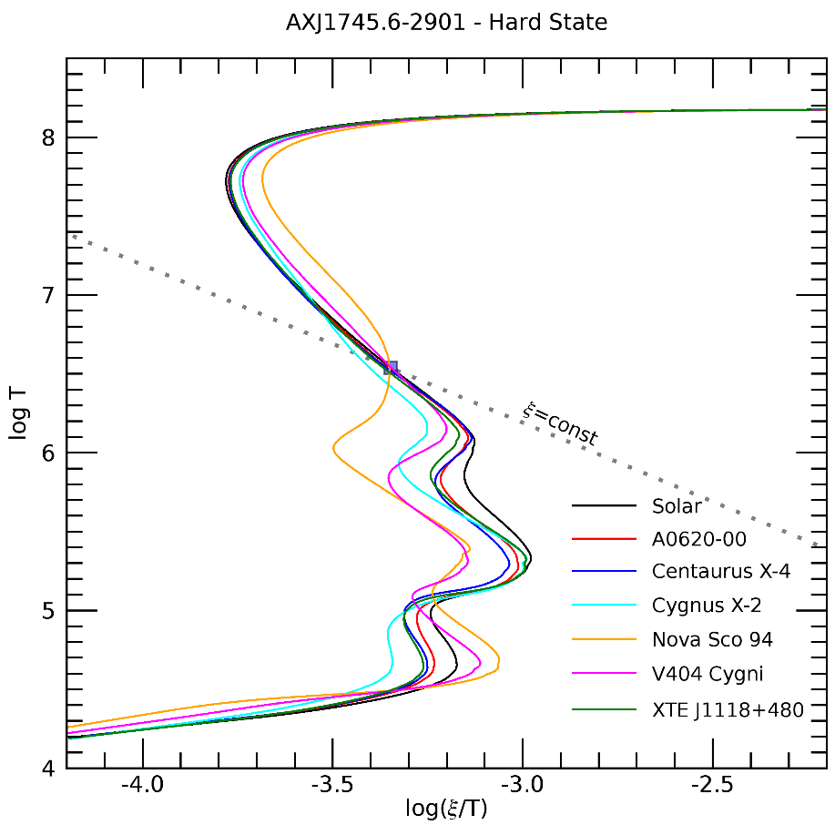
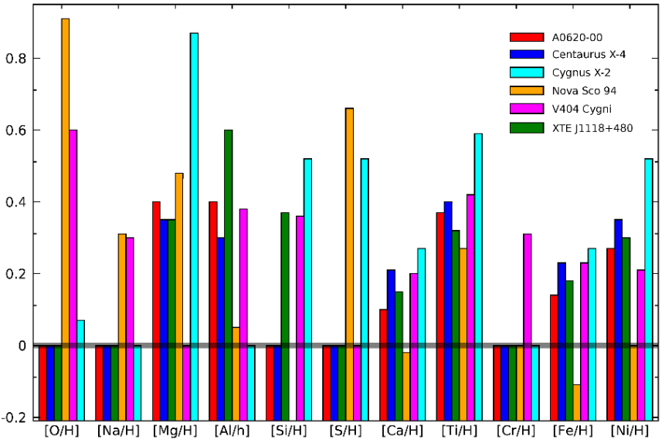
Abundances

Slide 17
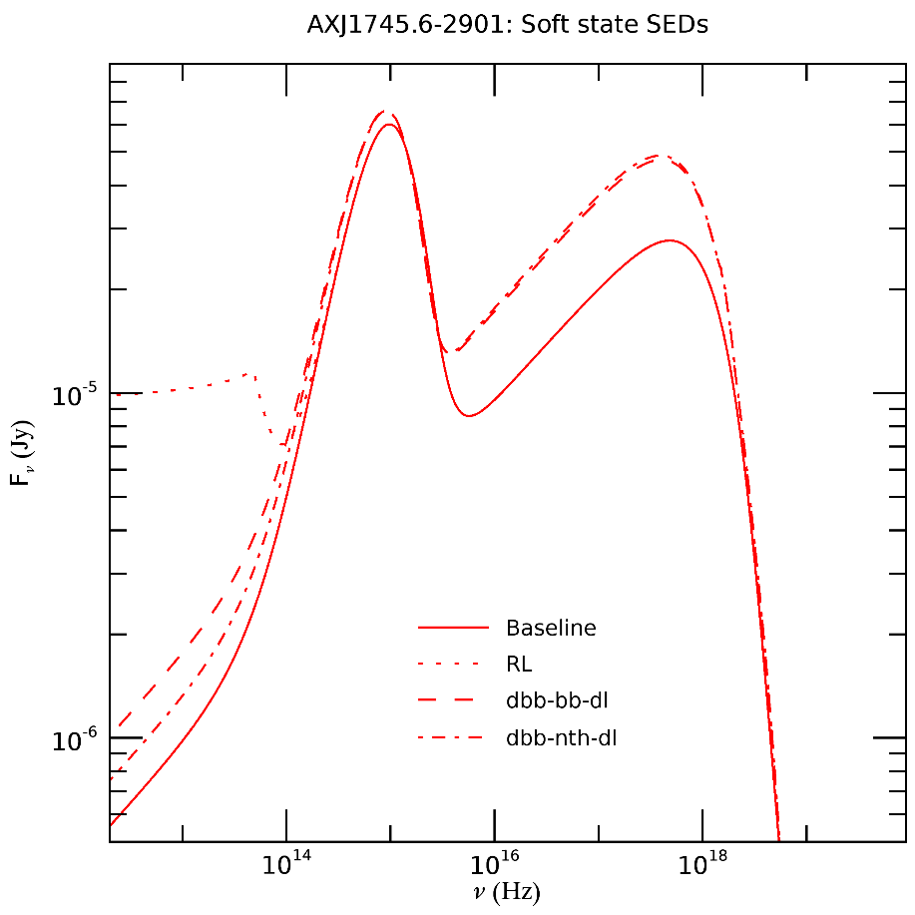
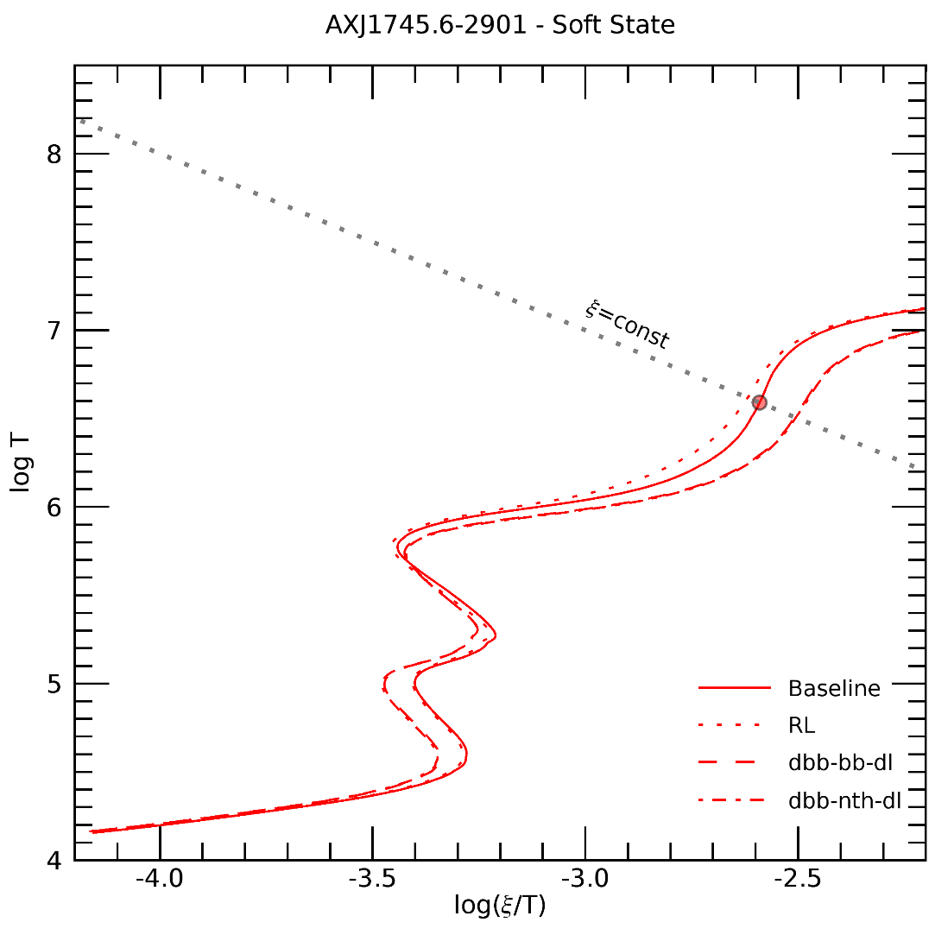
Other SEDs

Slide 18
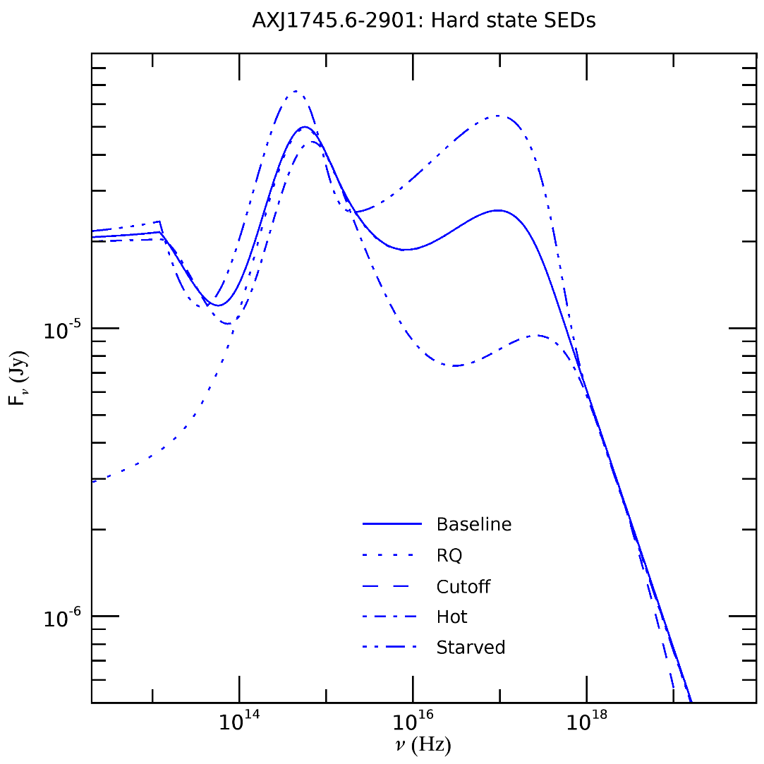
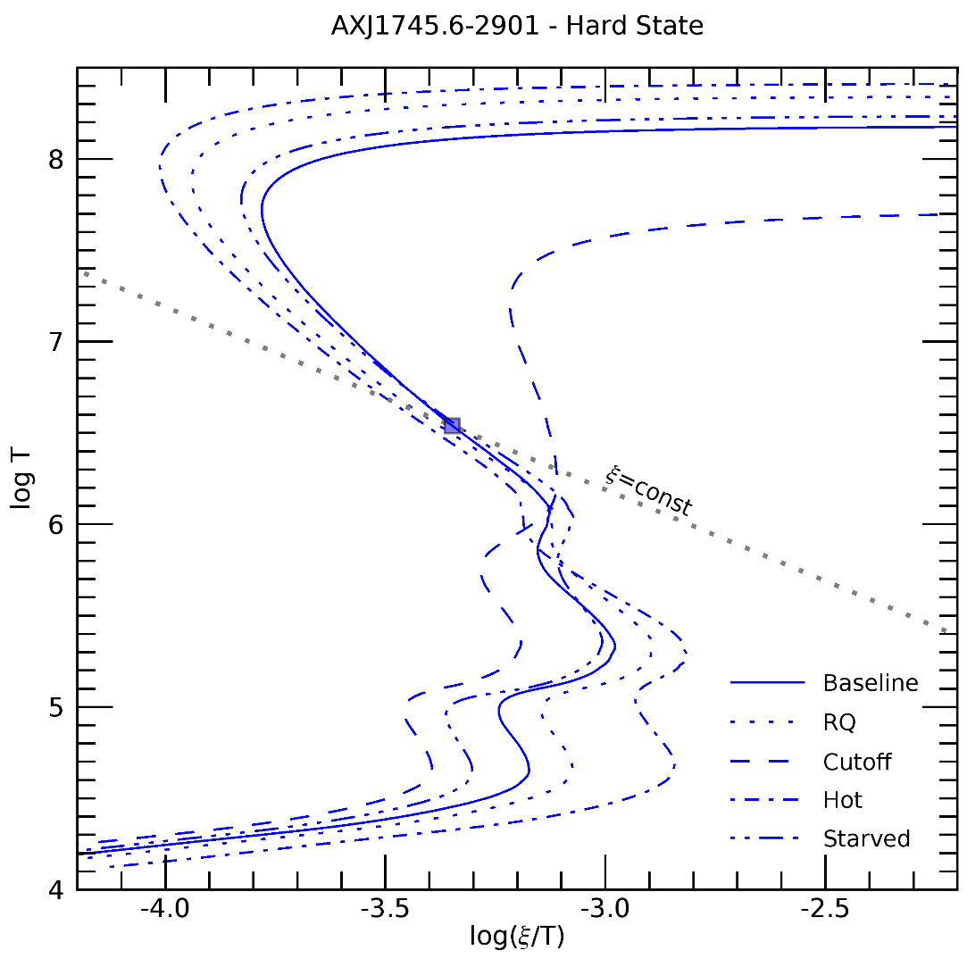
Other SEDs

