Slide 1


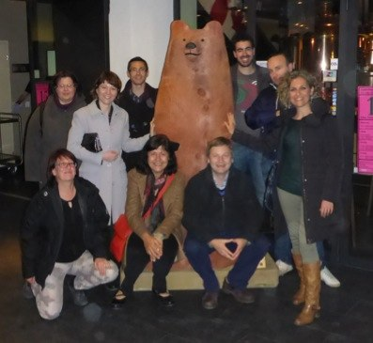
Unveiling the AGN activity in multiple SMBH systems
Stefano Bianchi
On behalf of the MAGNA Team
June 13th 2017 – Multifrequency Behavior of High Energy Cosmic Sources – Mondello, Italy

Slide 2


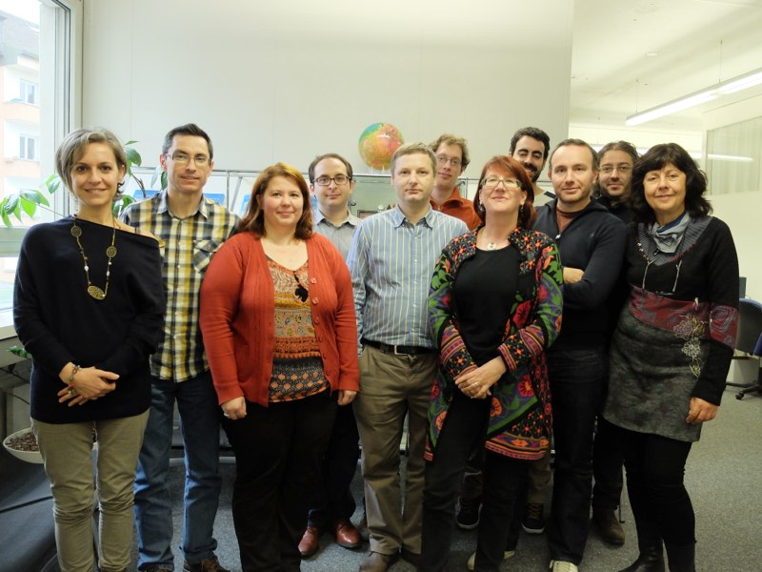
Multiple AGN Activity: Team members
Stefano Bianchi, Tamara Bogdanović, Alessandra De Rosa, Ruben Herrero-Illana, Bernd Husemann, Stefanie Komossa, Emma Kun, Nora Loiseau, Zsolt Paragi, Miguel Pérez-Torres, Enrico Piconcelli, Kevin Schawinski, Cristian Vignali, Jochen Heidt

Slide 3
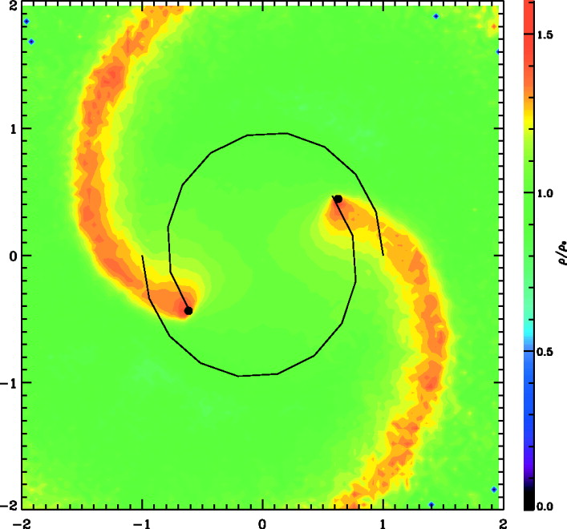
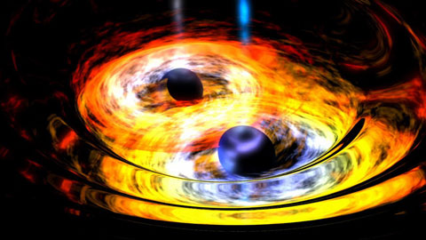
Escala+ 2004
Hierarchical merger models of galaxy formation predict that binary AGN should be common in galaxies (Haehnelt & Kauffmann 2002;Volonteri+ 2003)
Understanding the types of galaxies and specific merger stages where AGN pairs occur provides important clues about the peak of the black hole growth during the merging process
(Begelman+ 1980; Escala+ 2004)
Dual SMBHs are also invoked to account for many aspects of the AGN phenomenon (e.g., Komossa 2003):
formation of the torus
radio-loud/radio-quiet
distortions and bending of jets
Coalescing binary SMBHs are strong emitters of gravitational waves detectable with eLISA
NASA

Slide 4
Dynamical friction is thought to be a principal mechanism responsible for orbital evolution of massive black holes in the aftermath of galactic mergers and an important channel for formation of gravitationally bound SMBH binaries
Ionizing radiation from the innermost parts of the SMBH’s accretion flow renders dynamical friction inefficient
Streamlines
Density Contours
Distance (kpc)
Park & Bogdanović 2017

Slide 5
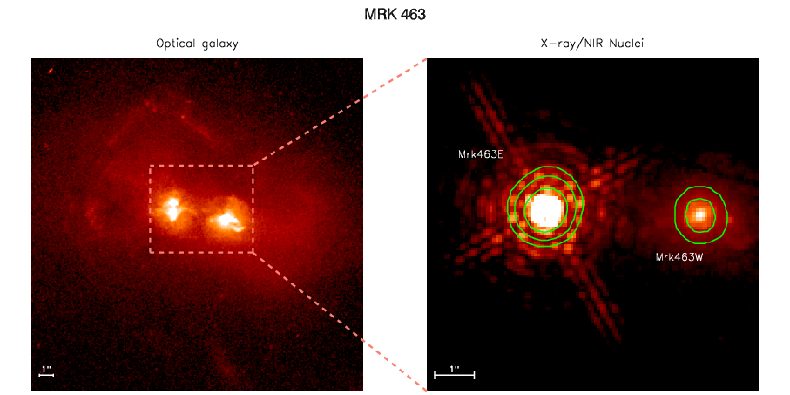
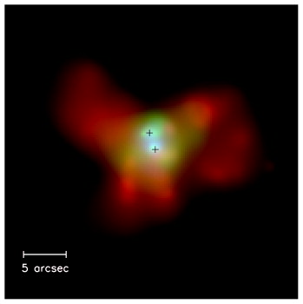
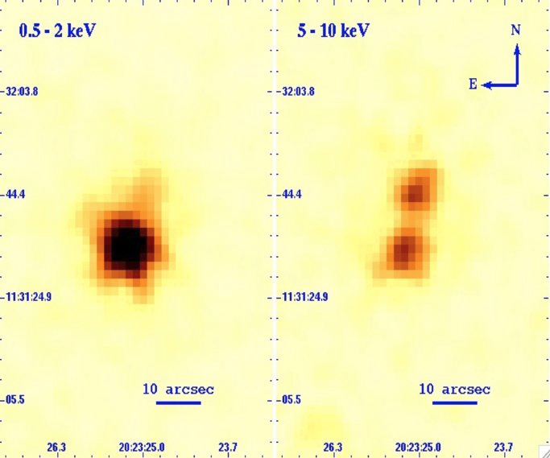
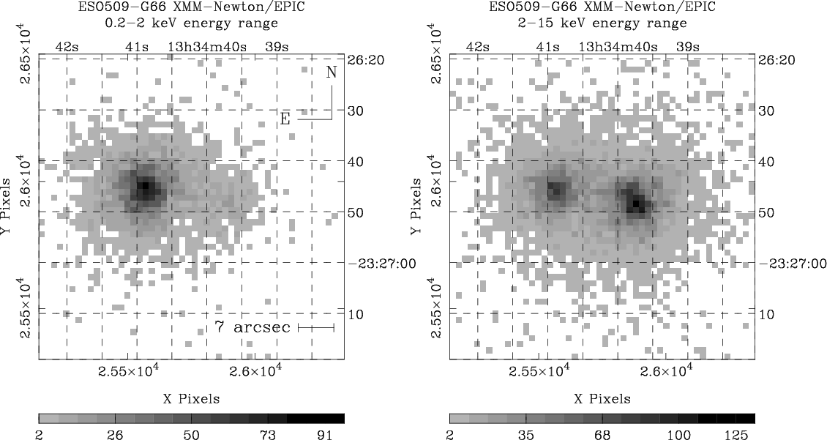
The first compact AGN pairs in advanced mergers and interacting galaxies have been identified in X-rays and in the radio band
Bianchi+ 2008
Piconcelli+ 2010
Komossa+ 2003
Guainazzi+ 2005

Slide 6
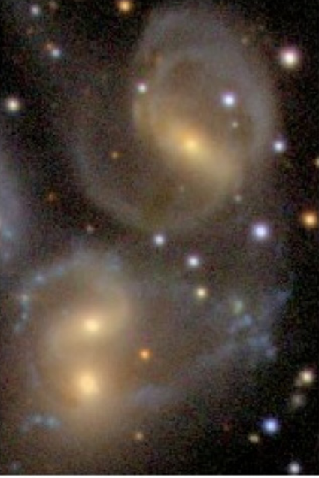
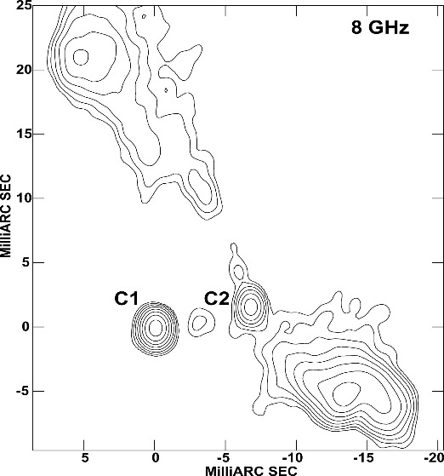
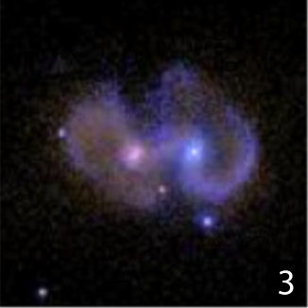
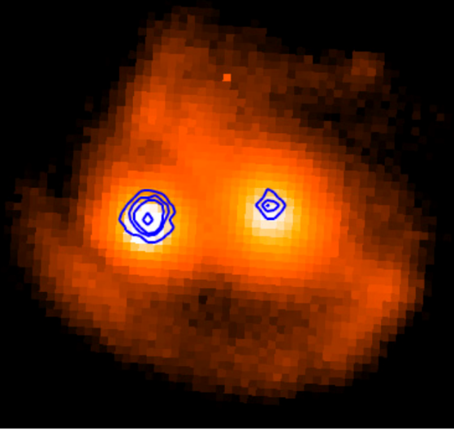
separation
radio
pc separation
IR
pc-kpc separations
X-rays (Chandra/XMM)
kpc scale
Hard X-rays
(Swift/BAT, Nustar)
250 kpc-Mpc
merger fraction higher with respect to optical selection but difficult AGN identification
biased against RQ AGN
High penetrative but still biased against heavily obscured AGN
MAGNA goal is the first systematic study of a well defined sample of multiple SMBHs using multiband information

Slide 7

MAGNA-Master Sample (MMS)
AGN systems optically classified (SDSS, Liu+11)
Sy-Sy systems through emitting line diagnostic (BPT diagram)
Max proj. dist $60$ kpc (only interacting systems)
(almost) Final sample of $16$ Systems
Proj. disc $\sim 10−60$ kpc and $z\sim 0.03−0.17$
XMM-Newton: 4 systems with ang sep. $>10’’$($\sim 200$ ks)
Chandra proposal for the systems with ang sep. $<10’’$
Multiwavelength observational campaign (VLA, EVN, MUSE, LBT)

Slide 8
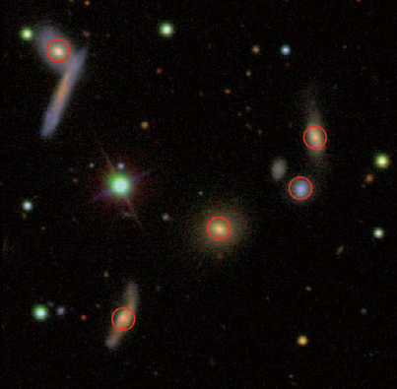
The quintet group SDSS 0959+1259
De Rosa & MAGNA team, 2015, MNRAS, 453, 214
z=0.03
The only Quintet group in the huge optical sample (Liu+11)
XMM 20 ks exposure
Follow-up 2.2 m telescope in Calar Alto BUSCA optical image
Composite gri SDSS image (100’’x100’’)

Slide 9
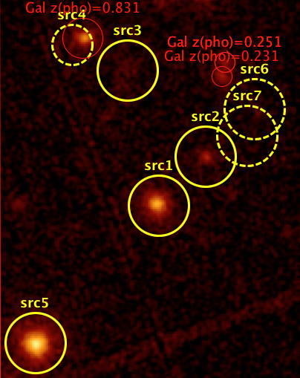
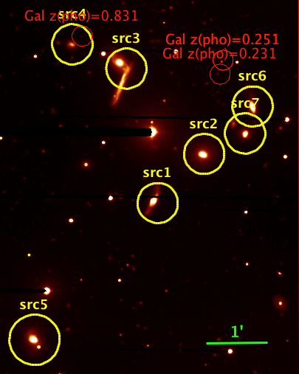
A crowded field
XMM pn+MOS12
BUSCA R-filter
Liu+11
~70 kpc (1.5 arcmin)
De Rosa+ 2015
~200 kpc (4.5 arcmin)

Slide 10
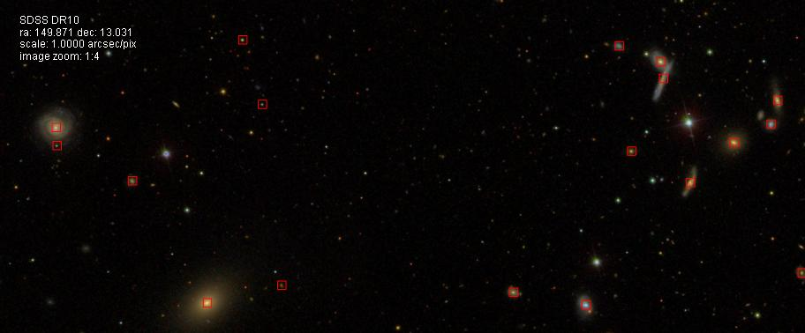
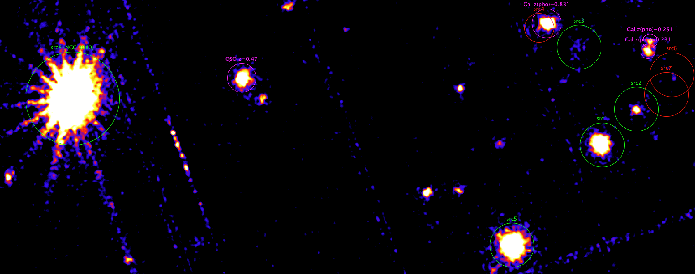
star
src3
src4
1’
Gal
z(pho)=0.054
src6
QSO
z=0.471
src8 (NGC 3080)
Gal
z=0.149
src7
star
src2
Gal
z=0.025
src1
Gal
z=0.024
Gal
z(pho)=0.097
Gal
z=0.065
src5
src3
src4
src6
src7
src1
src2
NGC3080
Liu
src5
600 kpc (15 arcmin)

Slide 11
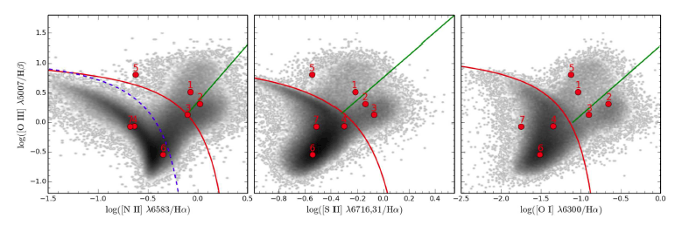
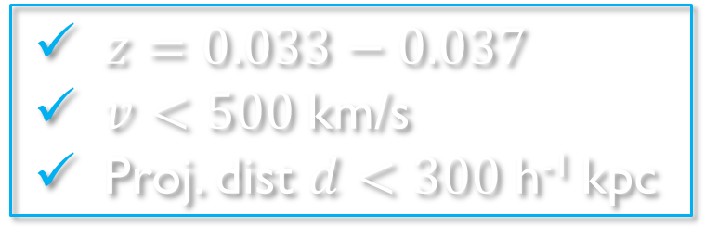
The galaxy compact group
The selection
The CG
$z=0.033−0.037$
$v<500$km/s
Proj. dist $d<300$h⁻¹ kpc
Type 2 AGN -- X-ray
LINER – X-Ray
LINER - X-ray
SFG – X ray UL
Type 2 AGN - X- ray
SFG - X ray UL
SFG - X ray UL
Type 1 AGN - X-ray

Slide 12
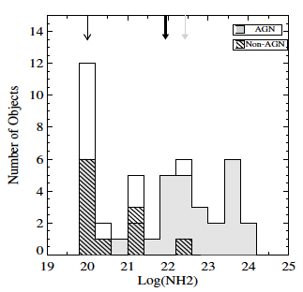
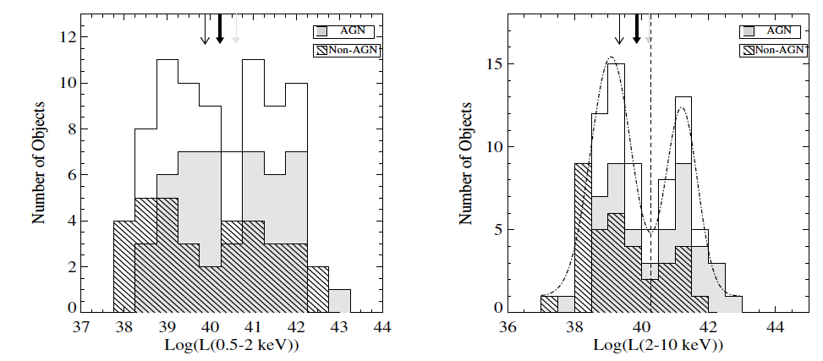
LINERs in our CG are likely accretion driven
Gonzales-Martin+2009
Notes:
Our LINER are likely accretion driven
LINER??

Slide 13
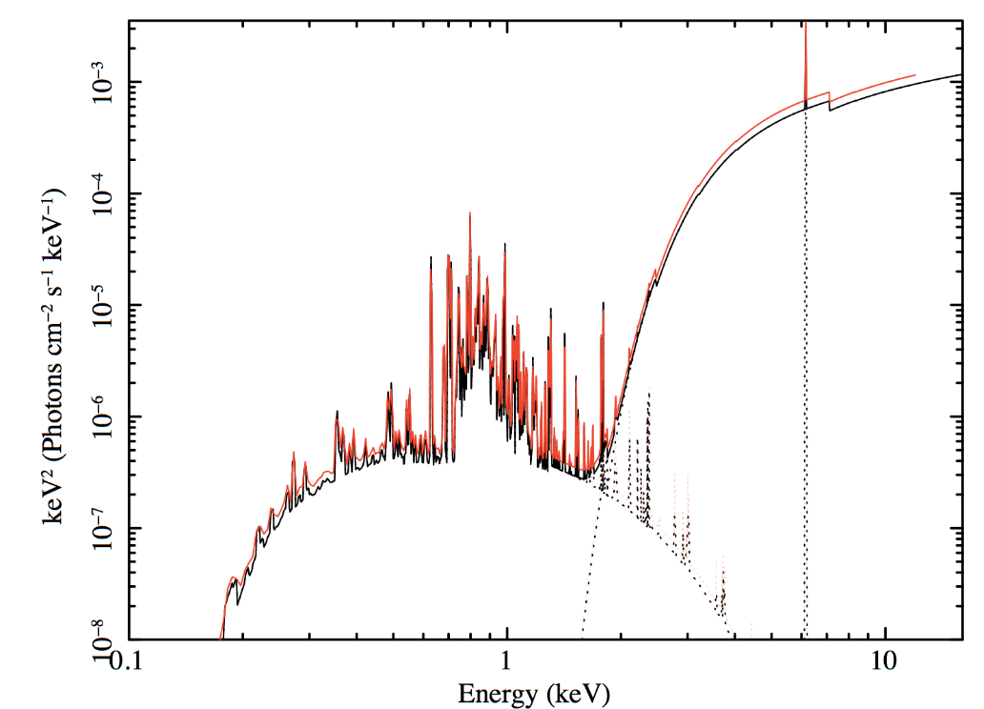
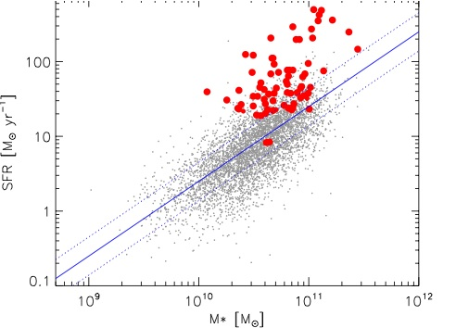

Enhanced star forming rate
z≈0
AGN
SFG
Enhanced Star Formation Rate if compared to the local universe (Elbaz+11)
High fraction of SFG (~40%) in our CG
Thermal component in Sy2s of our CG is highly significant: $1–2\%$ of $L_{0.5−2 keV}$: SFR<20 M⊙/yr (NLR emission is likely to contribute)

Slide 14

CG J0959+1259: a case study
High Fraction of AGN (or LINERs): $60\%$ (5 over 8)
X-ray study of 18 CGs ($L_{x}>{10}^{40}$ erg/s, B mag $<18$) showed less than $1$ AGN/group (Silverman+14)
Enhanced SFR
Rich HI gas morphology – tidal signatures/distortion
Very low [NII]/Hα possibly due to recent interaction

Slide 15

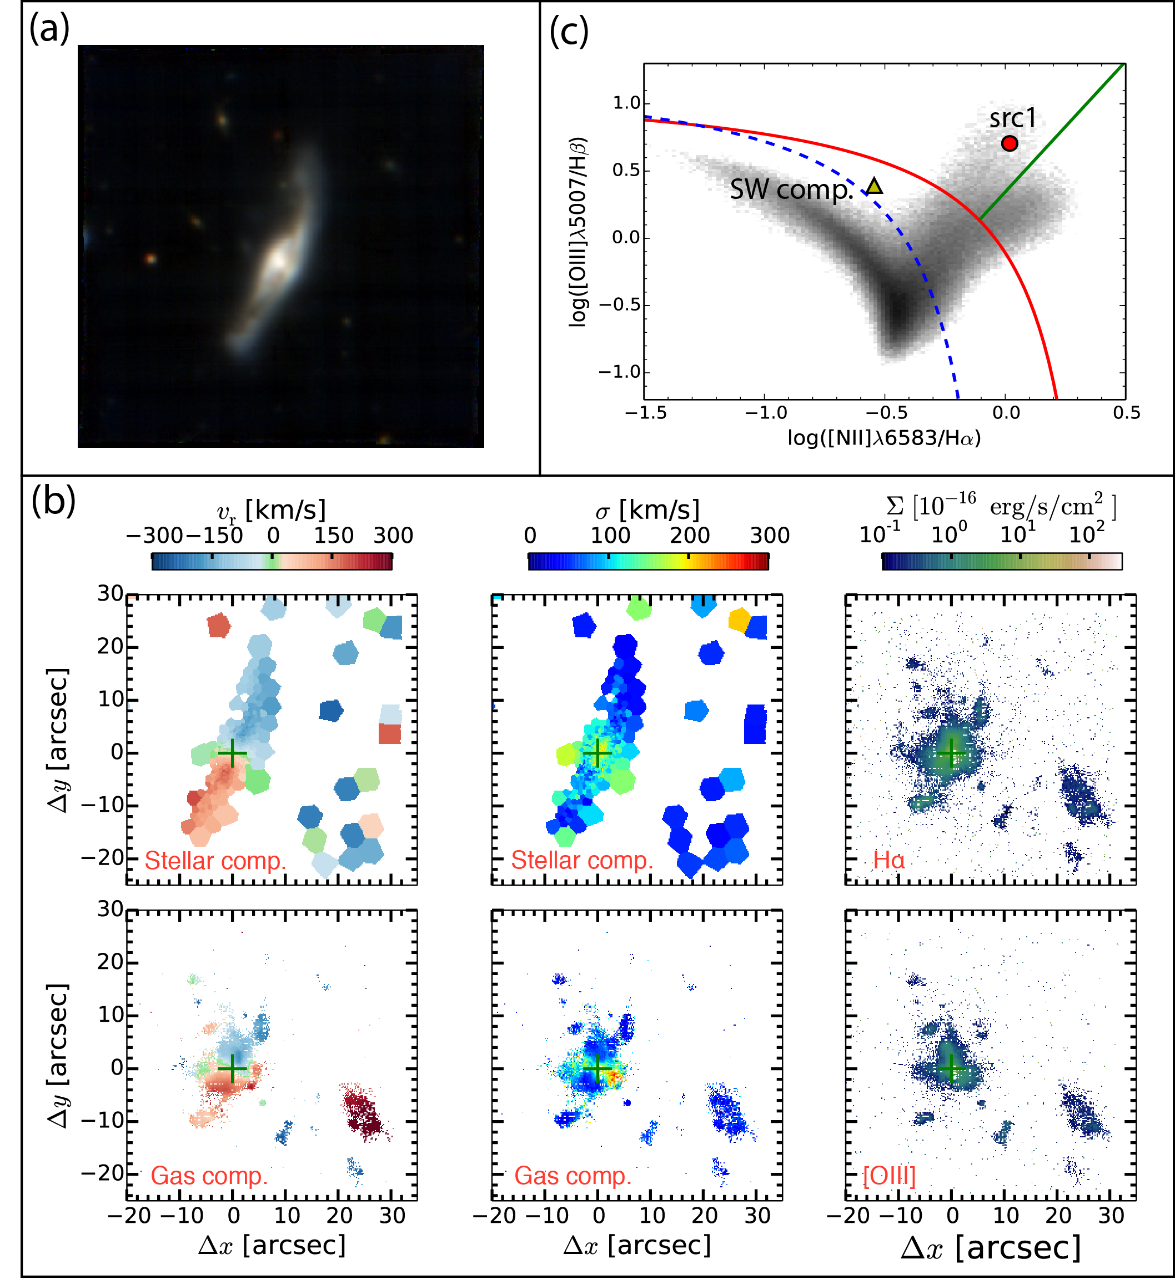
VLT MUSE
Husemann+ in prep.
A strong galactic wind in the ionized gas
A prominent ionized gas region to the SW, possibly indicative of a gas outflow
BPT: AGN-dominated region and the SW component in the star-forming dominated region
N
E
Velocity
Vel. disp
Surf. bright

Slide 16
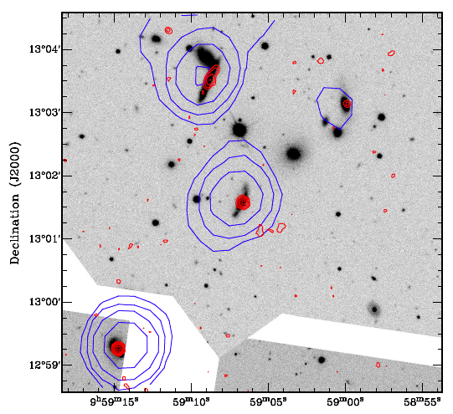

eEVN & VLA
AGN jets on $1−100$ pc scales / jet-induced star formation
LLAGN in the LINERS
LLAGN activity in SFG
The HI content in group members and intragroup medium (VLA)
The amounts of neutral (VLA HI) and ionized (MUSE Ha & [O iii]) in order to understand the feedback
SDSS with NVSS and FIRST
Paragi+ in prep.
Herrero-Illana+ in prep.

Slide 17
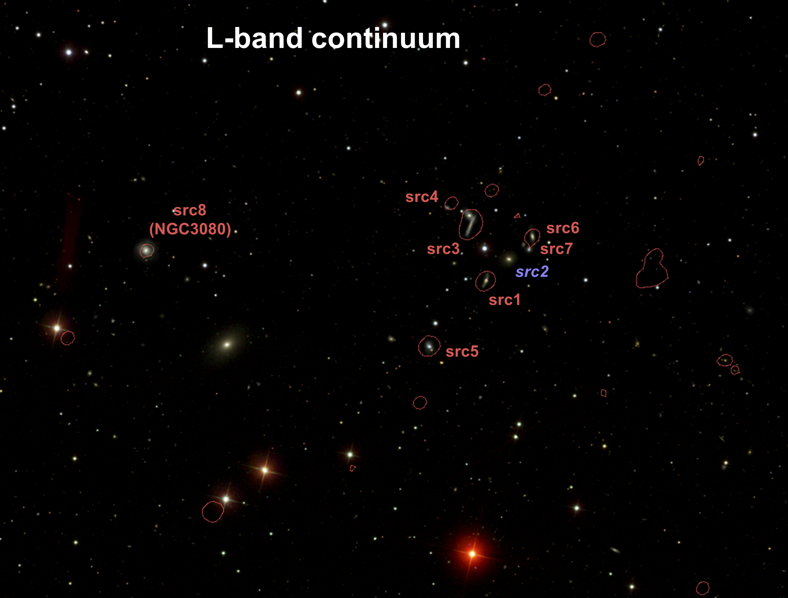
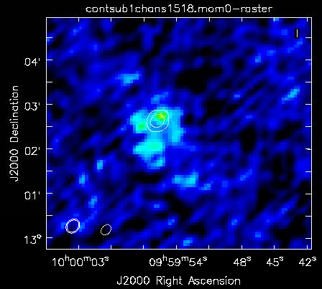
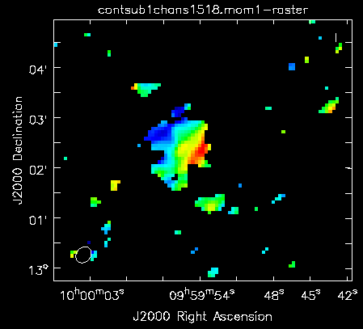
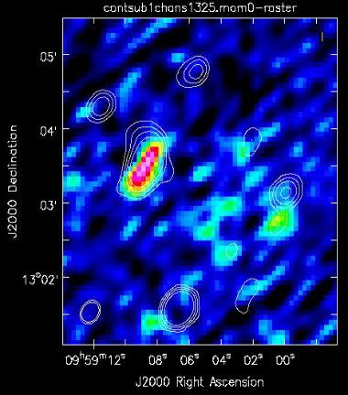
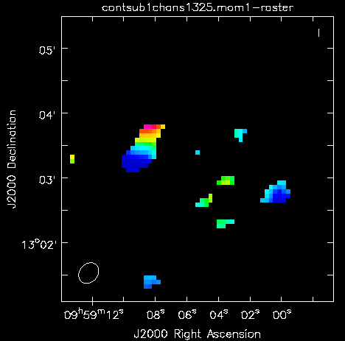
Molecular gas with the IRAM 30m telescope:
data soon for the three detected sources
IRAM 30m telescope to study the molecular gas properties
Herrero-Illana+ in prep.

Slide 18
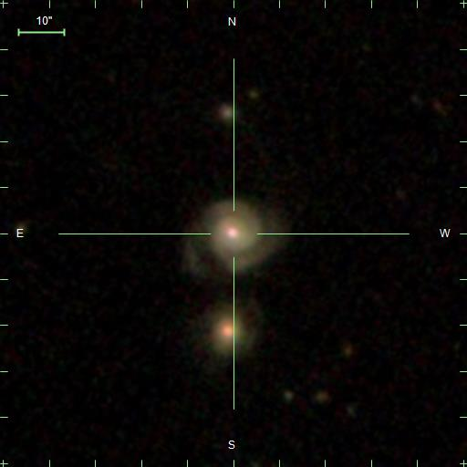
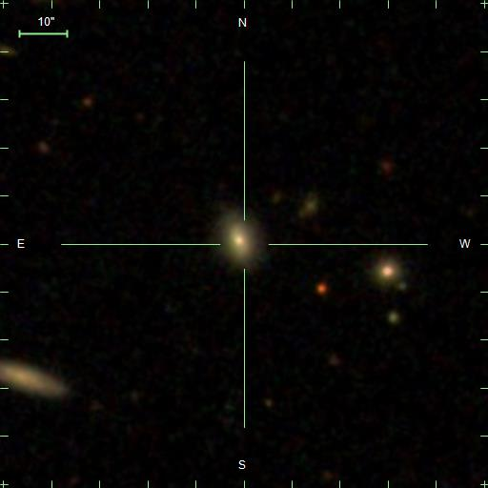
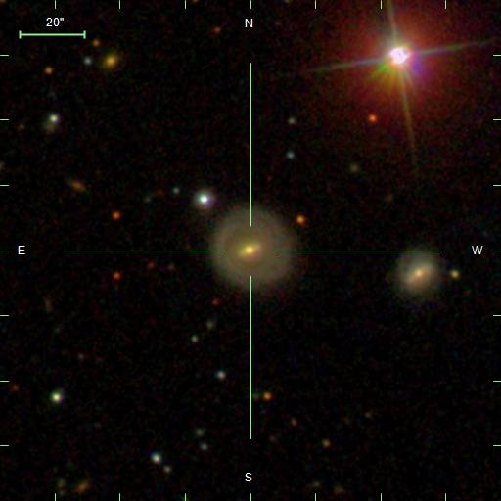
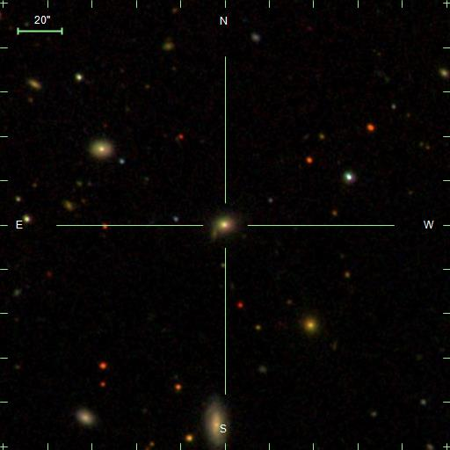
The XMM dual systems
10’’
10’’
z=0.055
Ang. Sep=40’’
Proj. Dist=43 kpc
SFR=7Msun/yr
z=0.075
Ang. Sep=21’’
Proj. Dist=30 kpc
SFR=20Msun/yr
De Rosa+MAGNA in prep.
20’’
20’’
z=0.045
Ang. Sep=70’’
Proj. Dist=59 kpc
SFR=2Msun/yr
z=0.048
Ang. Sep=54’’
Proj. Dist=50 kpc
SFR=0.5Msun/yr
SFR increases with decreasing separation
(SDSS+WISE: Chang+15)

Slide 19
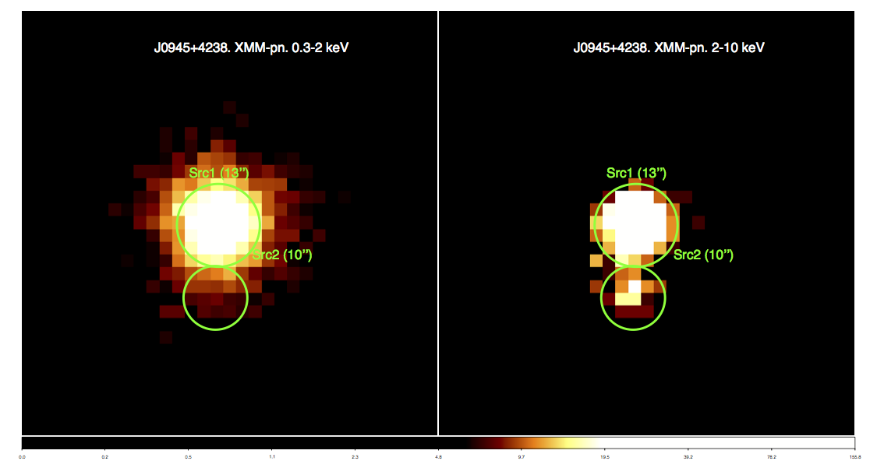
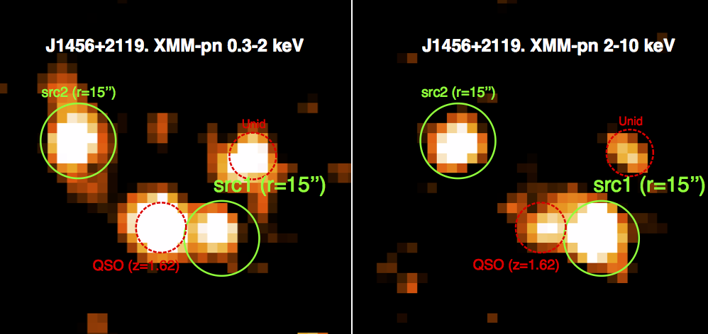
The X-ray images
0.3-2 keV
2-10 keV
De Rosa+MAGNA in prep.

Slide 20
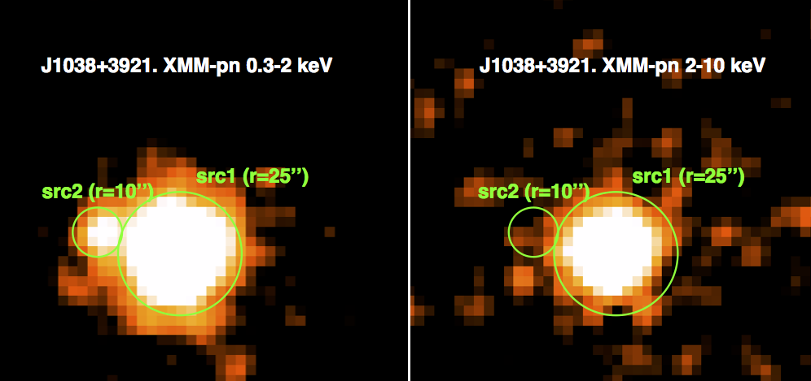
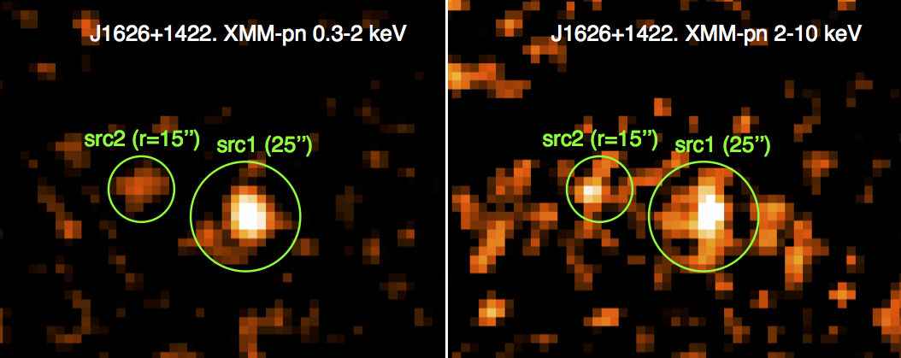
The X-ray images
De Rosa+MAGNA in prep.

Slide 21
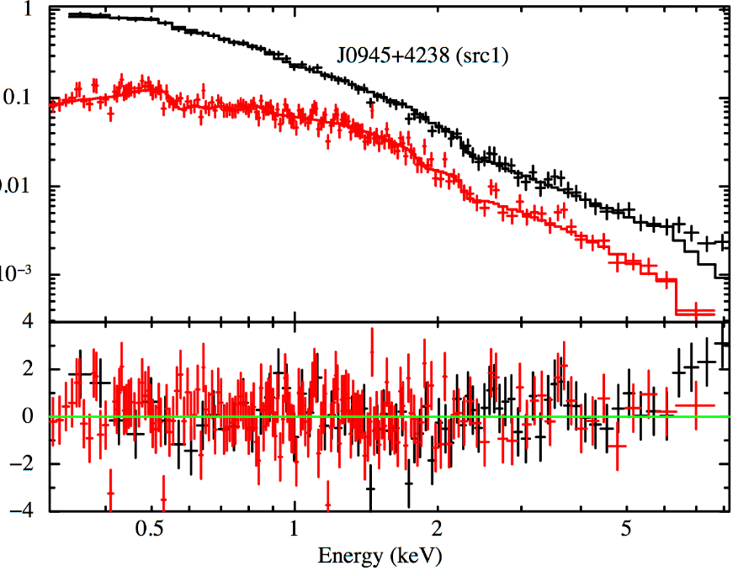
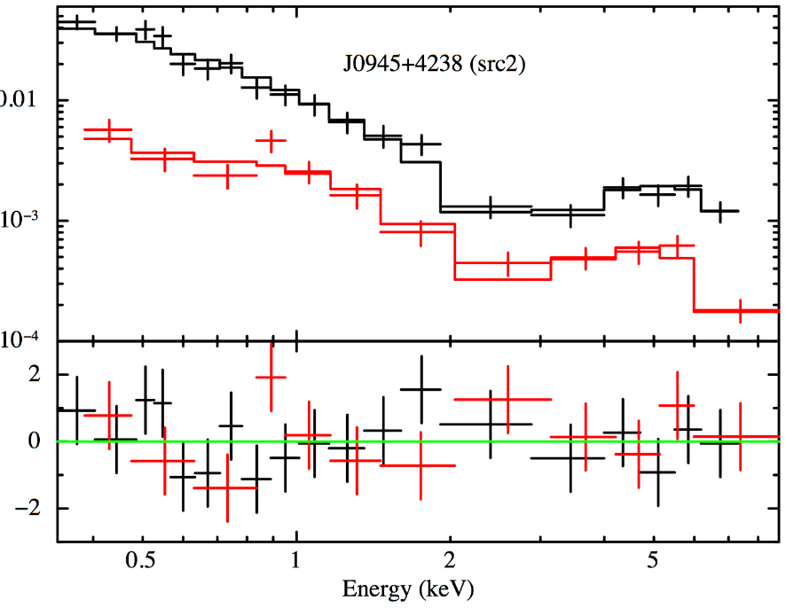
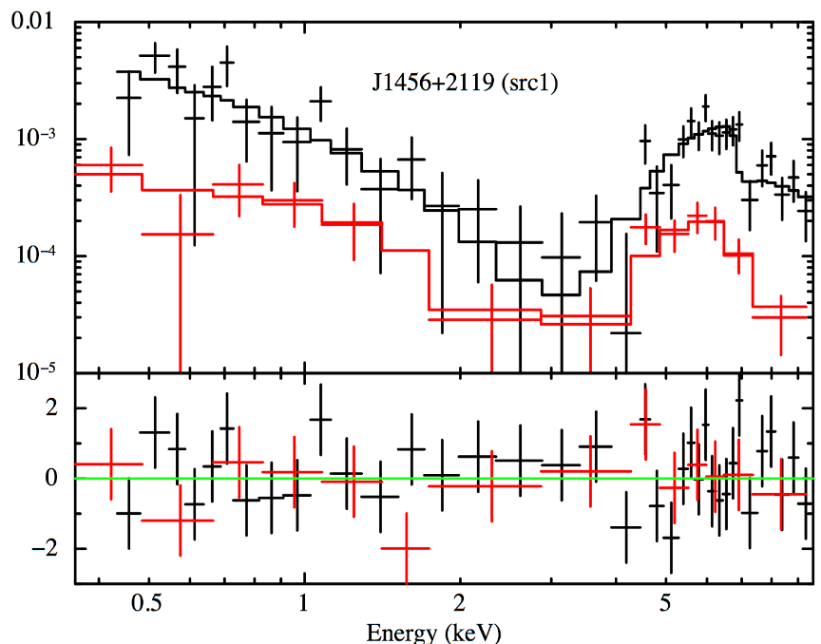
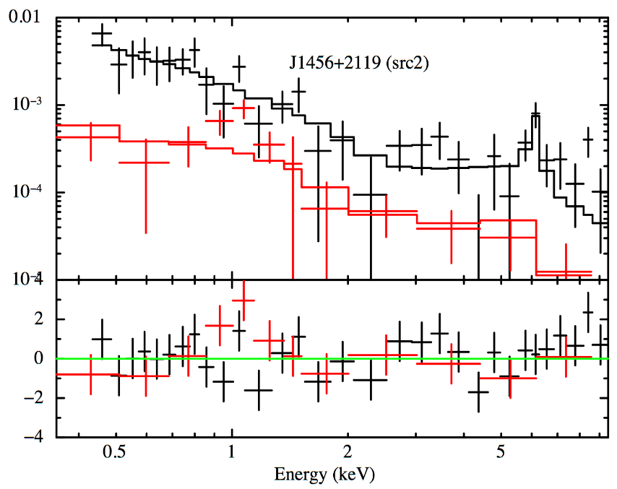
XMM observations I
The X-ray spectra
Unobscured
Compton-thin
De Rosa+MAGNA in prep.
Compton-thin
Compton-thick

Slide 22
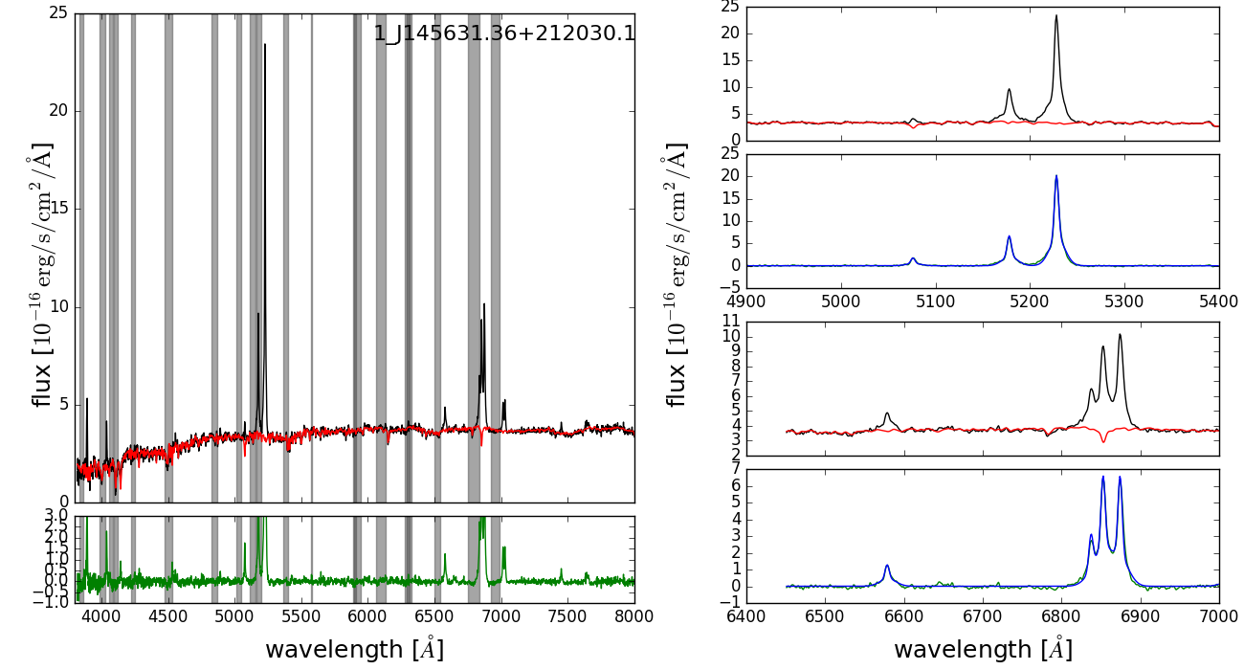
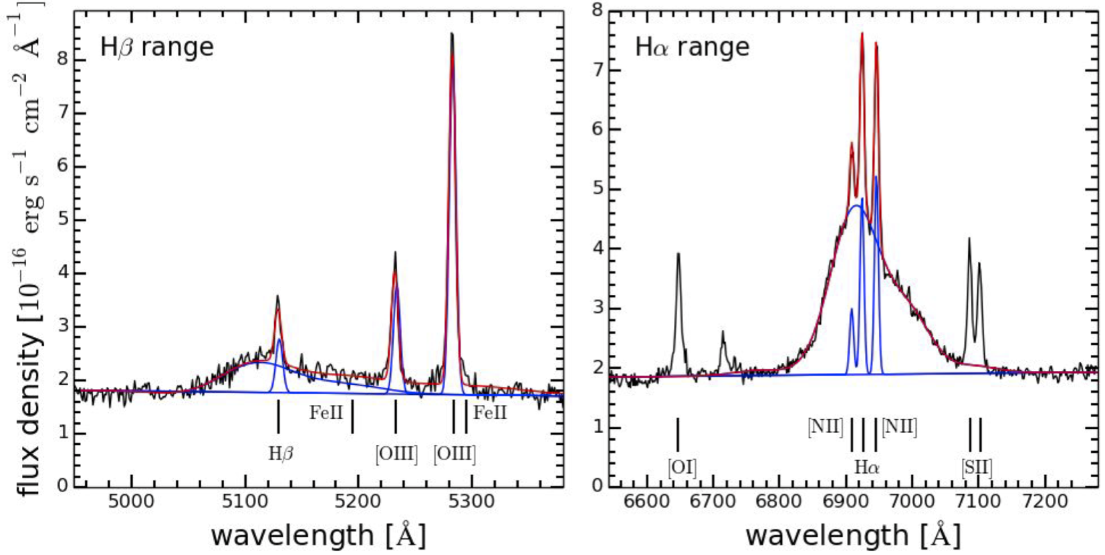

SDSS spectroscopy
The optical spectra
Type 2 AGN
$\sim 1000$km/s outflow
De Rosa+MAGNA in prep.
Type 1 AGN
(in agreement with X-rays)

Slide 23
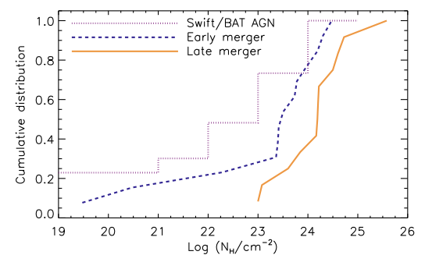
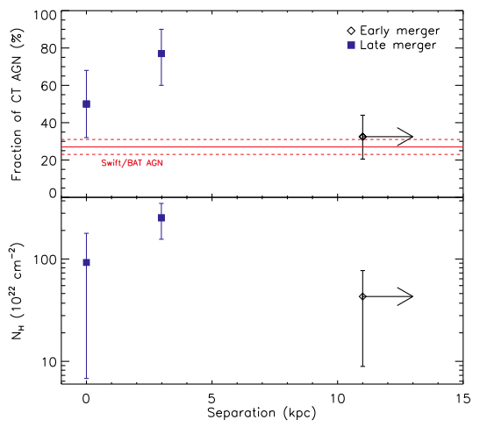


Obscuration vs merging
X-rays+SDSS: $60\%$ of our sample is obscured
AGN in late mergers are more obscured than those in early mergers and isolated AGN
AGN in late mergers have N_{H} ≥ 10²³ cm⁻²
Obscuration peak at a distance of $0.4–10.8$ kpc
Marginal evidence of decrease of N_{H} at the shortest distances (feedback from the final AGN remove obscuration?)
Ricci+17
Early merging
Late merging
Notes:
Cumulative NH distribution forAGNin early- (blue dashed line) and late-merger (orange continuous line) galaxies. For comparison, we also show the cumulative intrinsic NH distribution of local, mostly non-merging Swift/BAT AGN (purple dotted line) from Ricci et al. (2015). The plot shows that: (i) AGN in late mergers are systematically more obscured than those in early mergers and Swift/BATAGN; (ii) allAGNin late mergers haveNH ≥ 1023 cm−2,which implies that they are almost completely surrounded by material with NH ≥ 1023 cm−2. Following the approach described inCameron (2011), we found that the obscuring material covers 95+4 −8 per centof the X-ray source, where the uncertainties represent the 16th and 84th quantiles of a binomial distribution
Figure 12. Top panel: fraction of CT AGN versus the separation between the two galactic nuclei. U/LIRGs in the late stages of galaxy mergers are divided into objects with two nuclei and those with a single nucleus. The separation for U/LIRGs in late-merger stages showing two nuclei is set to the mean value of the distance, while for objects with a single nucleus we set it to zero kpc. The red continuous line represents the intrinsic fraction of CT AGN measured by Swift/BAT (Ricci et al. 2015) for local hard X-ray selected AGN. The uncertainties on fCT represent the 16th/84th quantiles of a binomial distribution. Bottom panel: median value of the line-of-sight column density versus the separation between the two galactic nuclei. The error bars on NH show the 1σ interval. The three objects (NGC 4922N, Arp 220W and NGC 7674) for which only a lower limit of NH could be constrained were assigned the minimum value. The two plots show that nuclear obscuration seems to peak when the two nuclei are at a distance of 0.4–10.8 kpc.imply

Slide 24
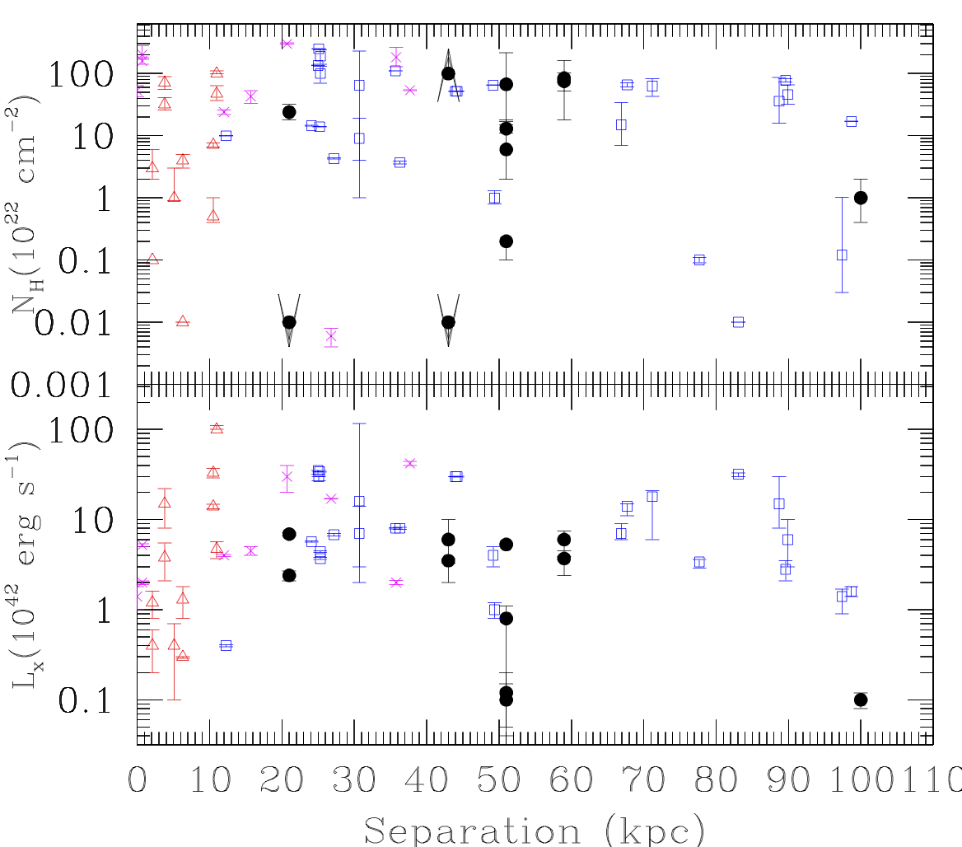

Dual system hosting AGN observed in X-rays
• Our systems
∆ SDSS detected
□Hard-X detected (Koss+12)
X IR detected (Ricci+17)
10²² cm⁻²
Type 1 unabsorbed AGN are unusual in merging/interacting systems
BUT they start to emerge at separation $<60$kpc
De Rosa+MAGNA in prep.
De Rosa+17,Koss+10, Ricci+17

Slide 25
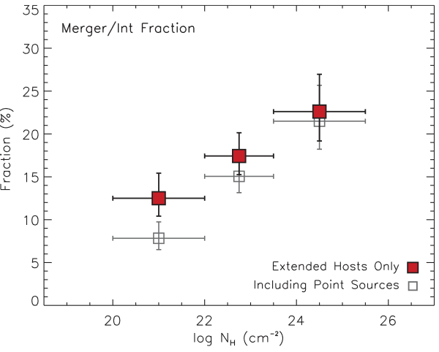

Obscuration vs morphology
Hosts of heavily obscured AGN are likely to be associated to disturbed morphologies
Merger-driven co-evolution predicts a strong dependence between obscuration and host properties such as morphology (Cattaneo+05; Hopkins+08)
obscured SMBH growth is a distinct phase in an evolutionary sequence following a merger event
AGN UM cannot explain such a correlation
Kocevski+15
Notes:
The increased fraction of disturbed morphologies with obscuration would appear to support an evolutionary scenario in which Compton-thick AGN are a distinct phase where the central SMBH undergoes rapid, obscured growth following a merger/interaction event

Slide 26

Summary
We studied multiband data of an optically selected sample of multiple galaxies hosting AGN
Obscuration ($1022$ cm⁻²) is present in about 60% of the sample
SFR increases for the closest separation systems ($20$ kpc)
Evidence of outflows in the closest systems ($<40$kpc)
“unusual” type 1 AGN are found in almost half of the sample
Work in progress
on-going VLA study of AGN pairs at very high angular resolution at $5$ and $10$ GHz: core-jet structures and environments
Chandra data for systems at lower separation ($<10’$’)
HCG J0959 a case study: MUSE - VLA eEVN observation

